Slide 1

Design of Non-Isolated DC-DC Converters for Maximum Power Point Tracking in Stand-Alone Photovoltaic System
Group – 1
Vishal Kevat (18EEE1029)
Burri Sai Bhargav (18EEE1007)
EE403 - Programme Major Project-1
Guided By –
Dr. Suresh Mikkili

Slide 2
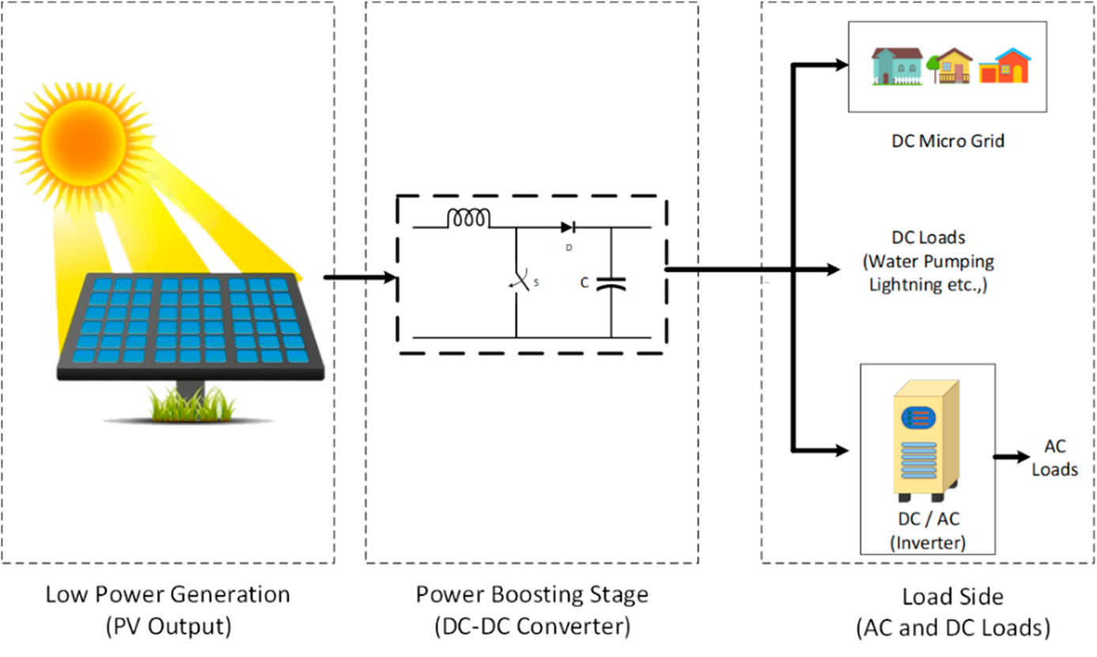
Introduction
The rapid increase in the demand for electricity and the recent change in the environmental conditions such as global warming led to a need for a new source of energy that is cheaper and sustainable. Solar energy has offered promising results in the quest of finding the solution to the problem.
Photovoltaic system mainly consist of three parts:
The Solar Panels or Module (solar irradiation energy to electric energy),
The interface part or desire Power section, to manages and induces electric energy obtained from PV system which are designed proportion to need of consumer
Third one is Electric Load
Solar PV integrated system with DC–DC converters fed to various loads

Slide 3
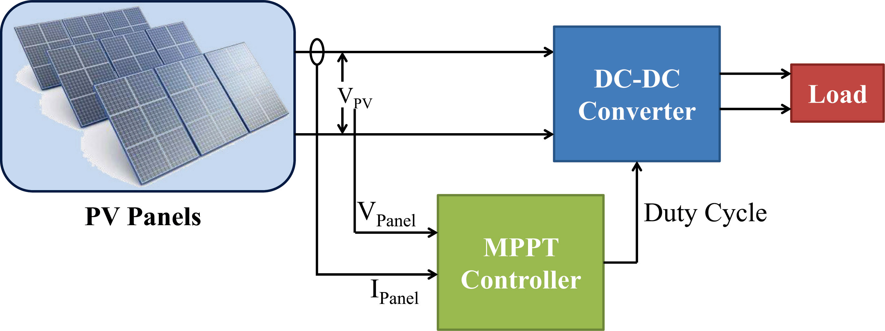
A maximum power point tracking (MPPT) technique is used for extracting the maximum power from the solar panel and transferring maximum power from the PV module to the load.
A DC-DC converter which interface between load and module, serve the purpose of transferring maximum power from PV module to the load. By changing the duty cycle the load impedance as seen by the source is varied and matched at the point of the peak power with the source so as to transfer the maximum power.
DC-DC converters are used in applications where an average output voltage is required, which can be higher or lower than the input voltage.
DC-DC converter for operation at the MPP

Slide 4
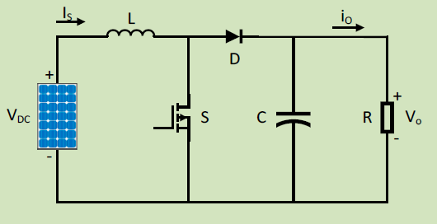
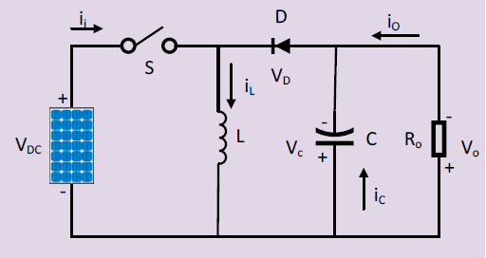
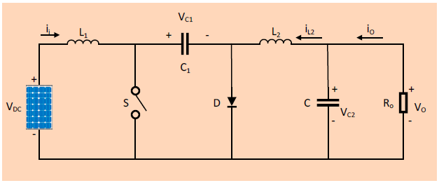
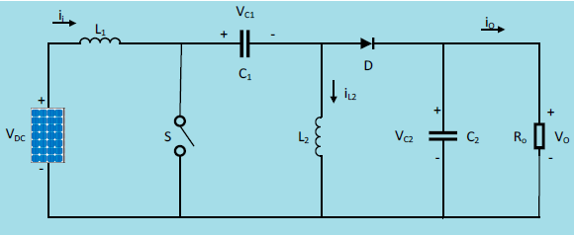
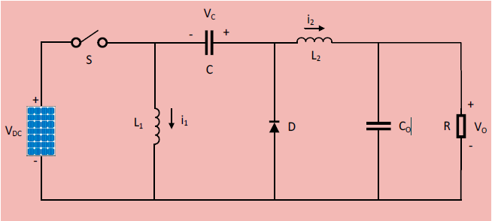
Non-Isolated DC-DC Converters (Conventional)
Boost Converter
Buck-Boost Converter
Cuk Converter
SEPIC Converter
Zeta Converter

Slide 5
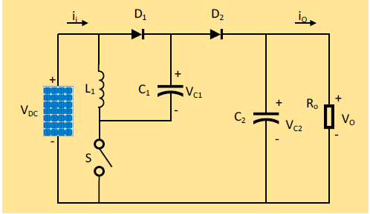
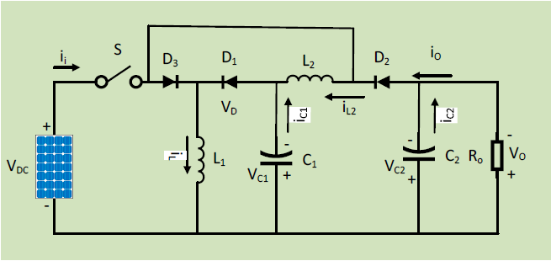
Non-Isolated DC-DC Converters (High Gain)
Positive Output Super-Lift Luo Converter
Ultra-Lift Luo Converter

Slide 6
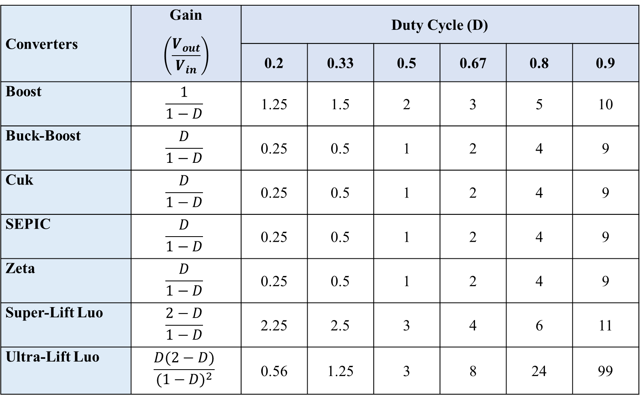
Comparison of Converters Gain
Converters | Gain $$\left(\frac{V_{out}}{V_{in}}\right)$$ | Duty Cycle (D)
 |  | 0.2 | 0.33 | 0.5 | 0.67 | 0.8 | 0.9
Boost | $$\frac{1}{1−D}$$ | 1.25 | 1.5 | 2 | 3 | 5 | 10
Buck-Boost | $$\frac{D}{1−D}$$ | 0.25 | 0.5 | 1 | 2 | 4 | 9
Cuk | $$\frac{D}{1−D}$$ | 0.25 | 0.5 | 1 | 2 | 4 | 9
SEPIC | $$\frac{D}{1−D}$$ | 0.25 | 0.5 | 1 | 2 | 4 | 9
Zeta | $$\frac{D}{1−D}$$ | 0.25 | 0.5 | 1 | 2 | 4 | 9
Super-Lift Luo | $$\frac{2−D}{1−D}$$ | 2.25 | 2.5 | 3 | 4 | 6 | 11
Ultra-Lift Luo | $$\frac{D(2−D)}{{(1−D)}^{2}}$$ | 0.56 | 1.25 | 3 | 8 | 24 | 99

Slide 7
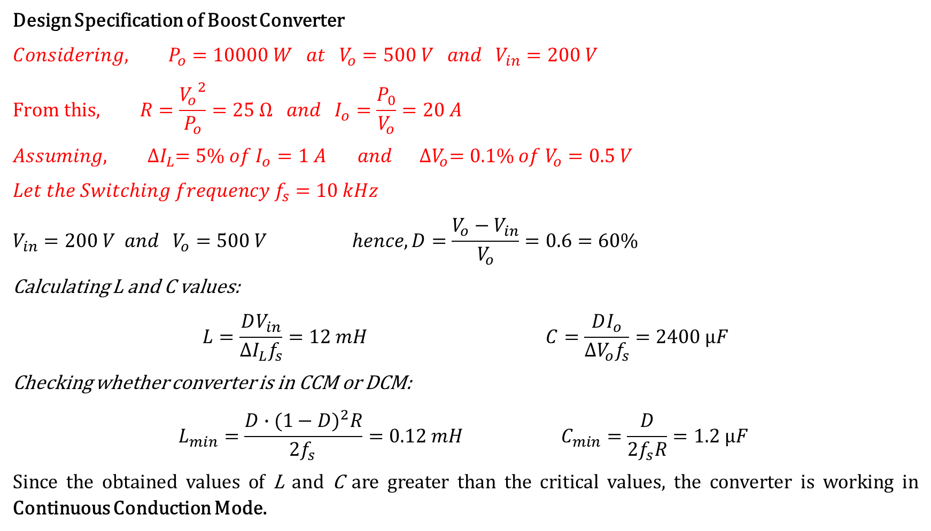
Designing of Converters
Design Specification of Boost Converter
$${Considering, P}_{o}=10000 W at V_{o}=500 V and V_{in}=200 V$$
$$From this, R=\frac{{V_{o}}^{2}}{P_{o}}=25 Ω and I_{o}=\frac{P_{0}}{V_{o}}=20 A$$
$$Assuming, {∆I}_{L}=5\% of I_{o}=1 A and {∆V}_{o}=0.1\% of V_{o}=0.5 V$$
$$Let the Switching frequency f_{s}=10 kHz$$
$$V_{in}=200 V and V_{o}=500 V hence, D=\frac{V_{o}−V_{in}}{V_{o}}=0.6=60\%$$
Calculating L and C values:
$$L=\frac{DV_{in}}{{∆I}_{L}f_{s}}=12 mH C=\frac{DI_{o}}{{∆V}_{o}f_{s}}=2400 µF$$
Checking whether converter is in CCM or DCM:
$$L_{min}=\frac{{D∙(1−D)}^{2}R}{2f_{s }}=0.12 mH C_{min}=\frac{D}{2f_{s}R}=1.2 µF$$
Since the obtained values of L and C are greater than the critical values, the converter is working in Continuous Conduction Mode.

Slide 8
Design Specifications of Converters
Elements Converters | L₁ (mH) | L₂ (mH) | C₁ (µF) | C₂ (µF) | R (Ω)
Boost | 12 | - | - | 2400 | 25
Buck-Boost | 14.3 | - | - | 2900 | 25
Cuk | 14.3 | 14.3 | 571.43 | 25 | 25
SEPIC | 14.3 | 14.3 | 571.43 | 2900 | 25
Zeta | 14.3 | 14.3 | 571.43 | 25 | 25
Super-Lift Luo | 6.7 | - | 2700 | 2700 | 25
Ultra-Lift Luo | 9.3 | 17.4 | 696.67 | 1900 | 25

Slide 9
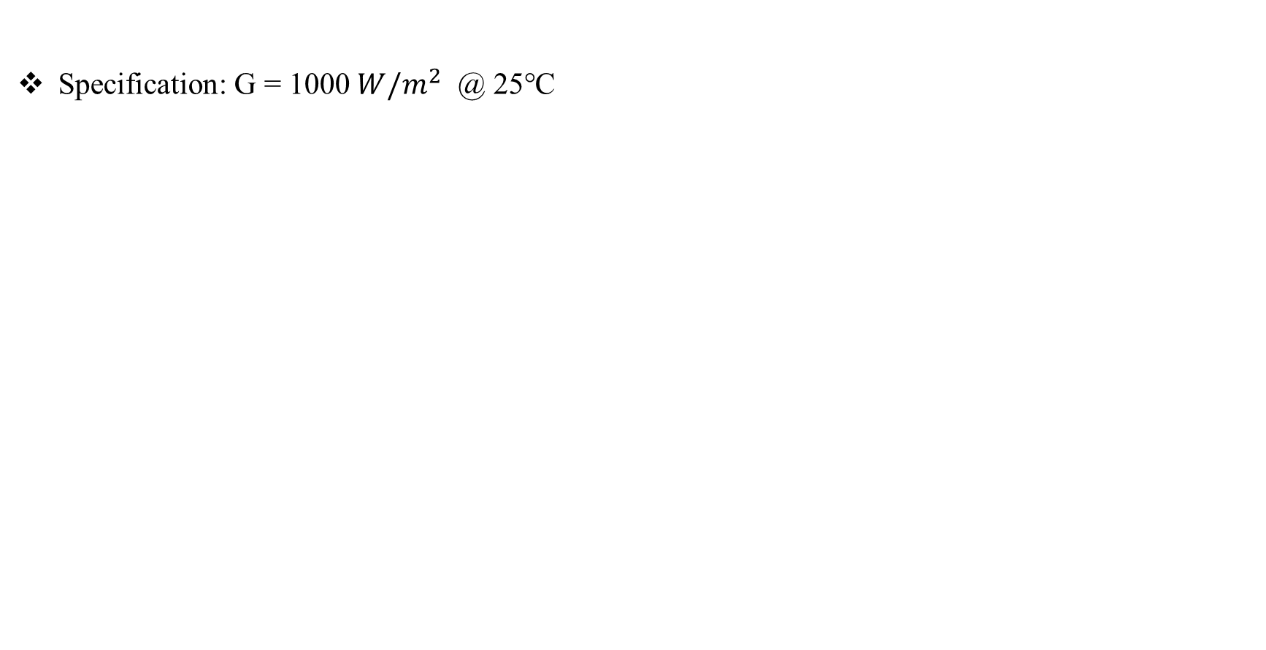
PV Panel (Kyocera Solar KC200GT) Parameters
Specification: G = 1000 $W/m^{2}$ @ 25℃
Parameters | Value
Maximum Power (W) | 200.143
Voltage at maximum power point Vmp (V) | 26.3
Current at maximum power point Imp (A) | 7.61
Open circuit voltage Voc (V) | 32.9
Short-circuit current Isc (A) | 8.21
Temperature coefficient of Voc (%/deg.C) | -0.355
Temperature coefficient of Isc (%/deg.C) | 0.06

Slide 10
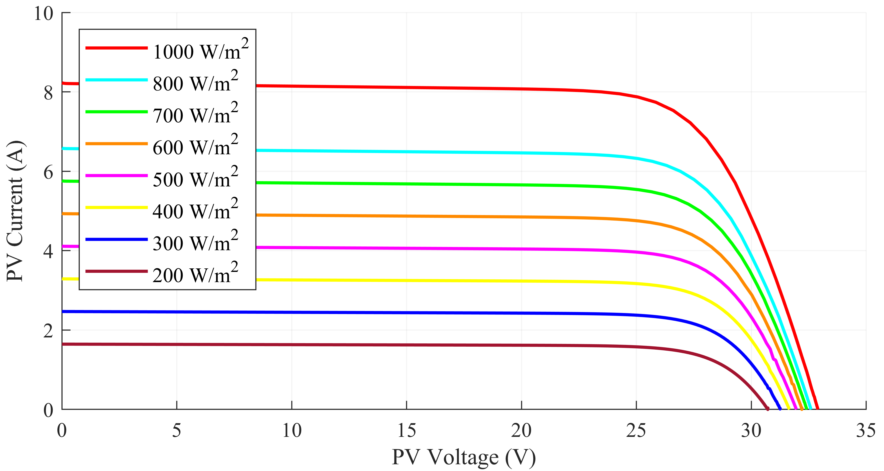
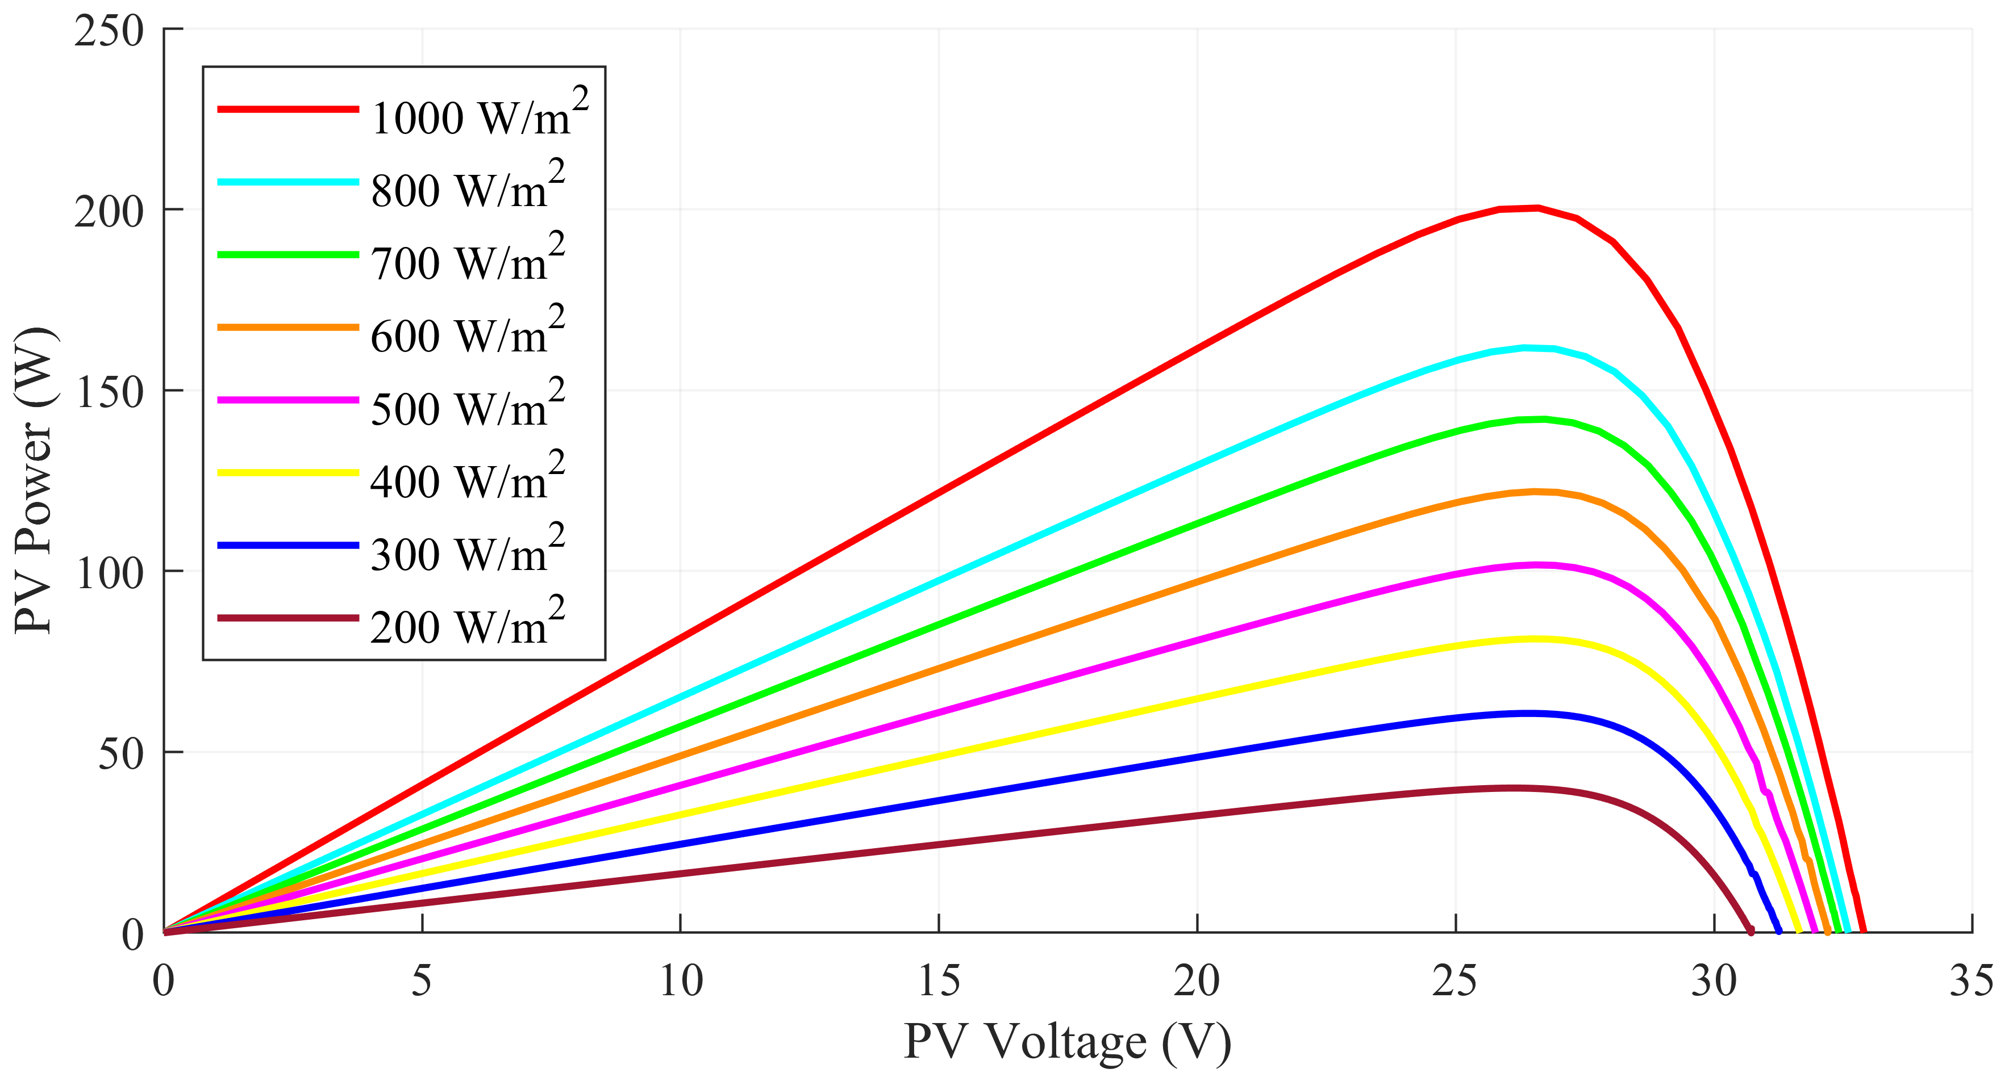
PV Characteristics of PV Module
I-V Characteristics of PV Module
P-V Characteristics of PV Module

Slide 11
Total-Cross-Tied PV Array Configuration

Slide 12
Partial Shading Conditions on PV Array
Center Shading Scenario
Corner Shading Scenario
Diagonal Shading Scenario
Frame Shading Scenario
Insolation Levels
Random Shading Scenario
Right Side End Shading Scenario

Slide 13
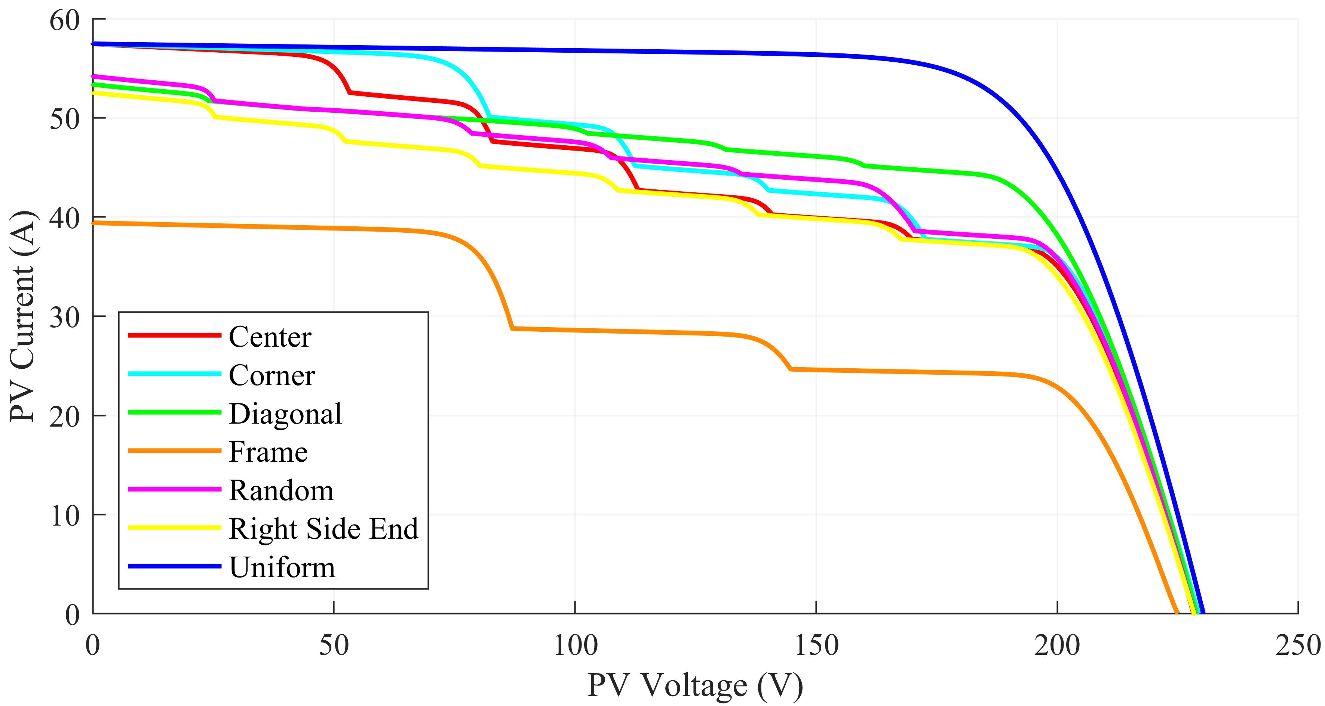
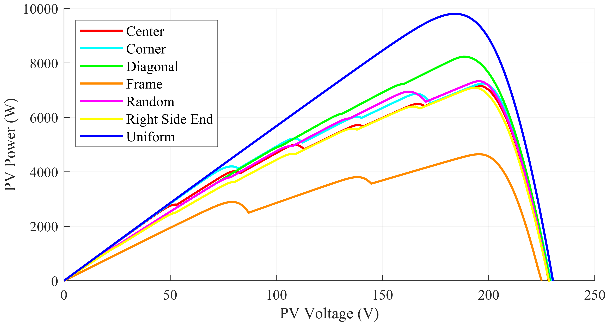
PV Characteristics of TCT PV Array under Partial Shading Conditions
I-V Characteristics of TCT PV Array under PSCs
P-V Characteristics of TCT PV Array under PSCs

Slide 14
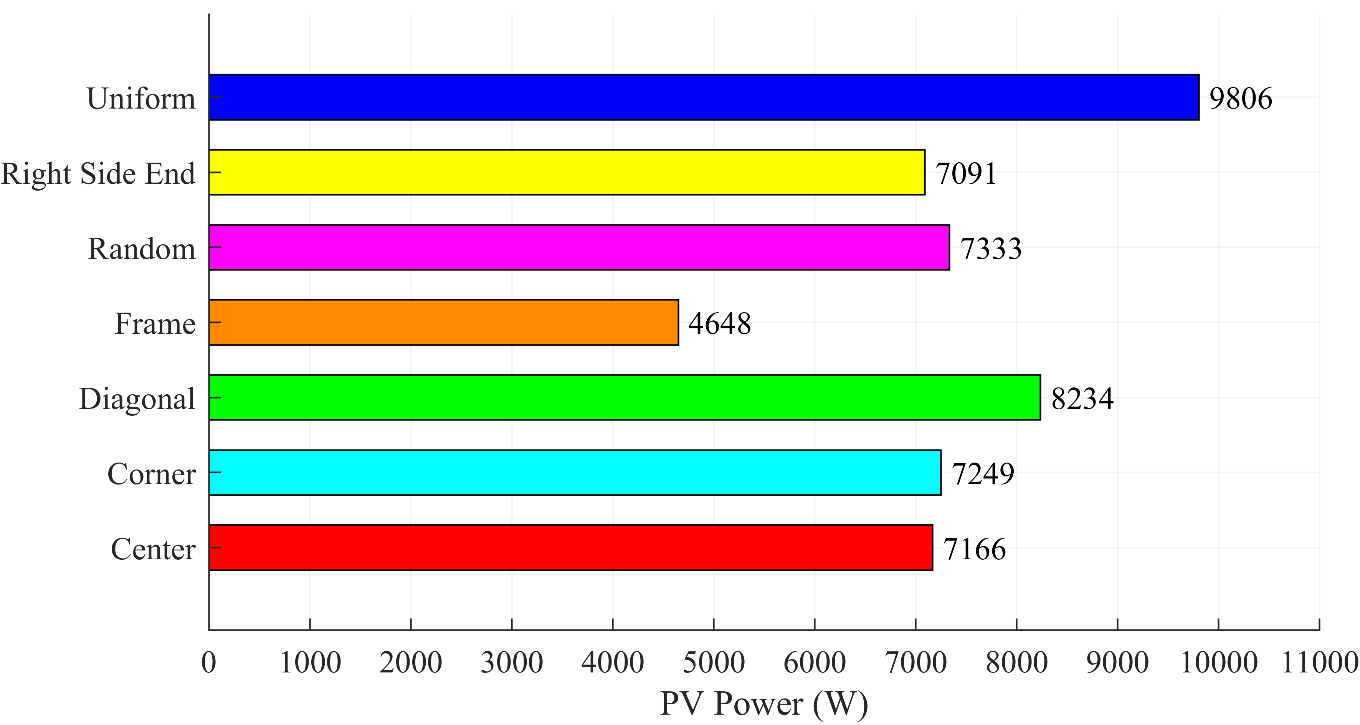
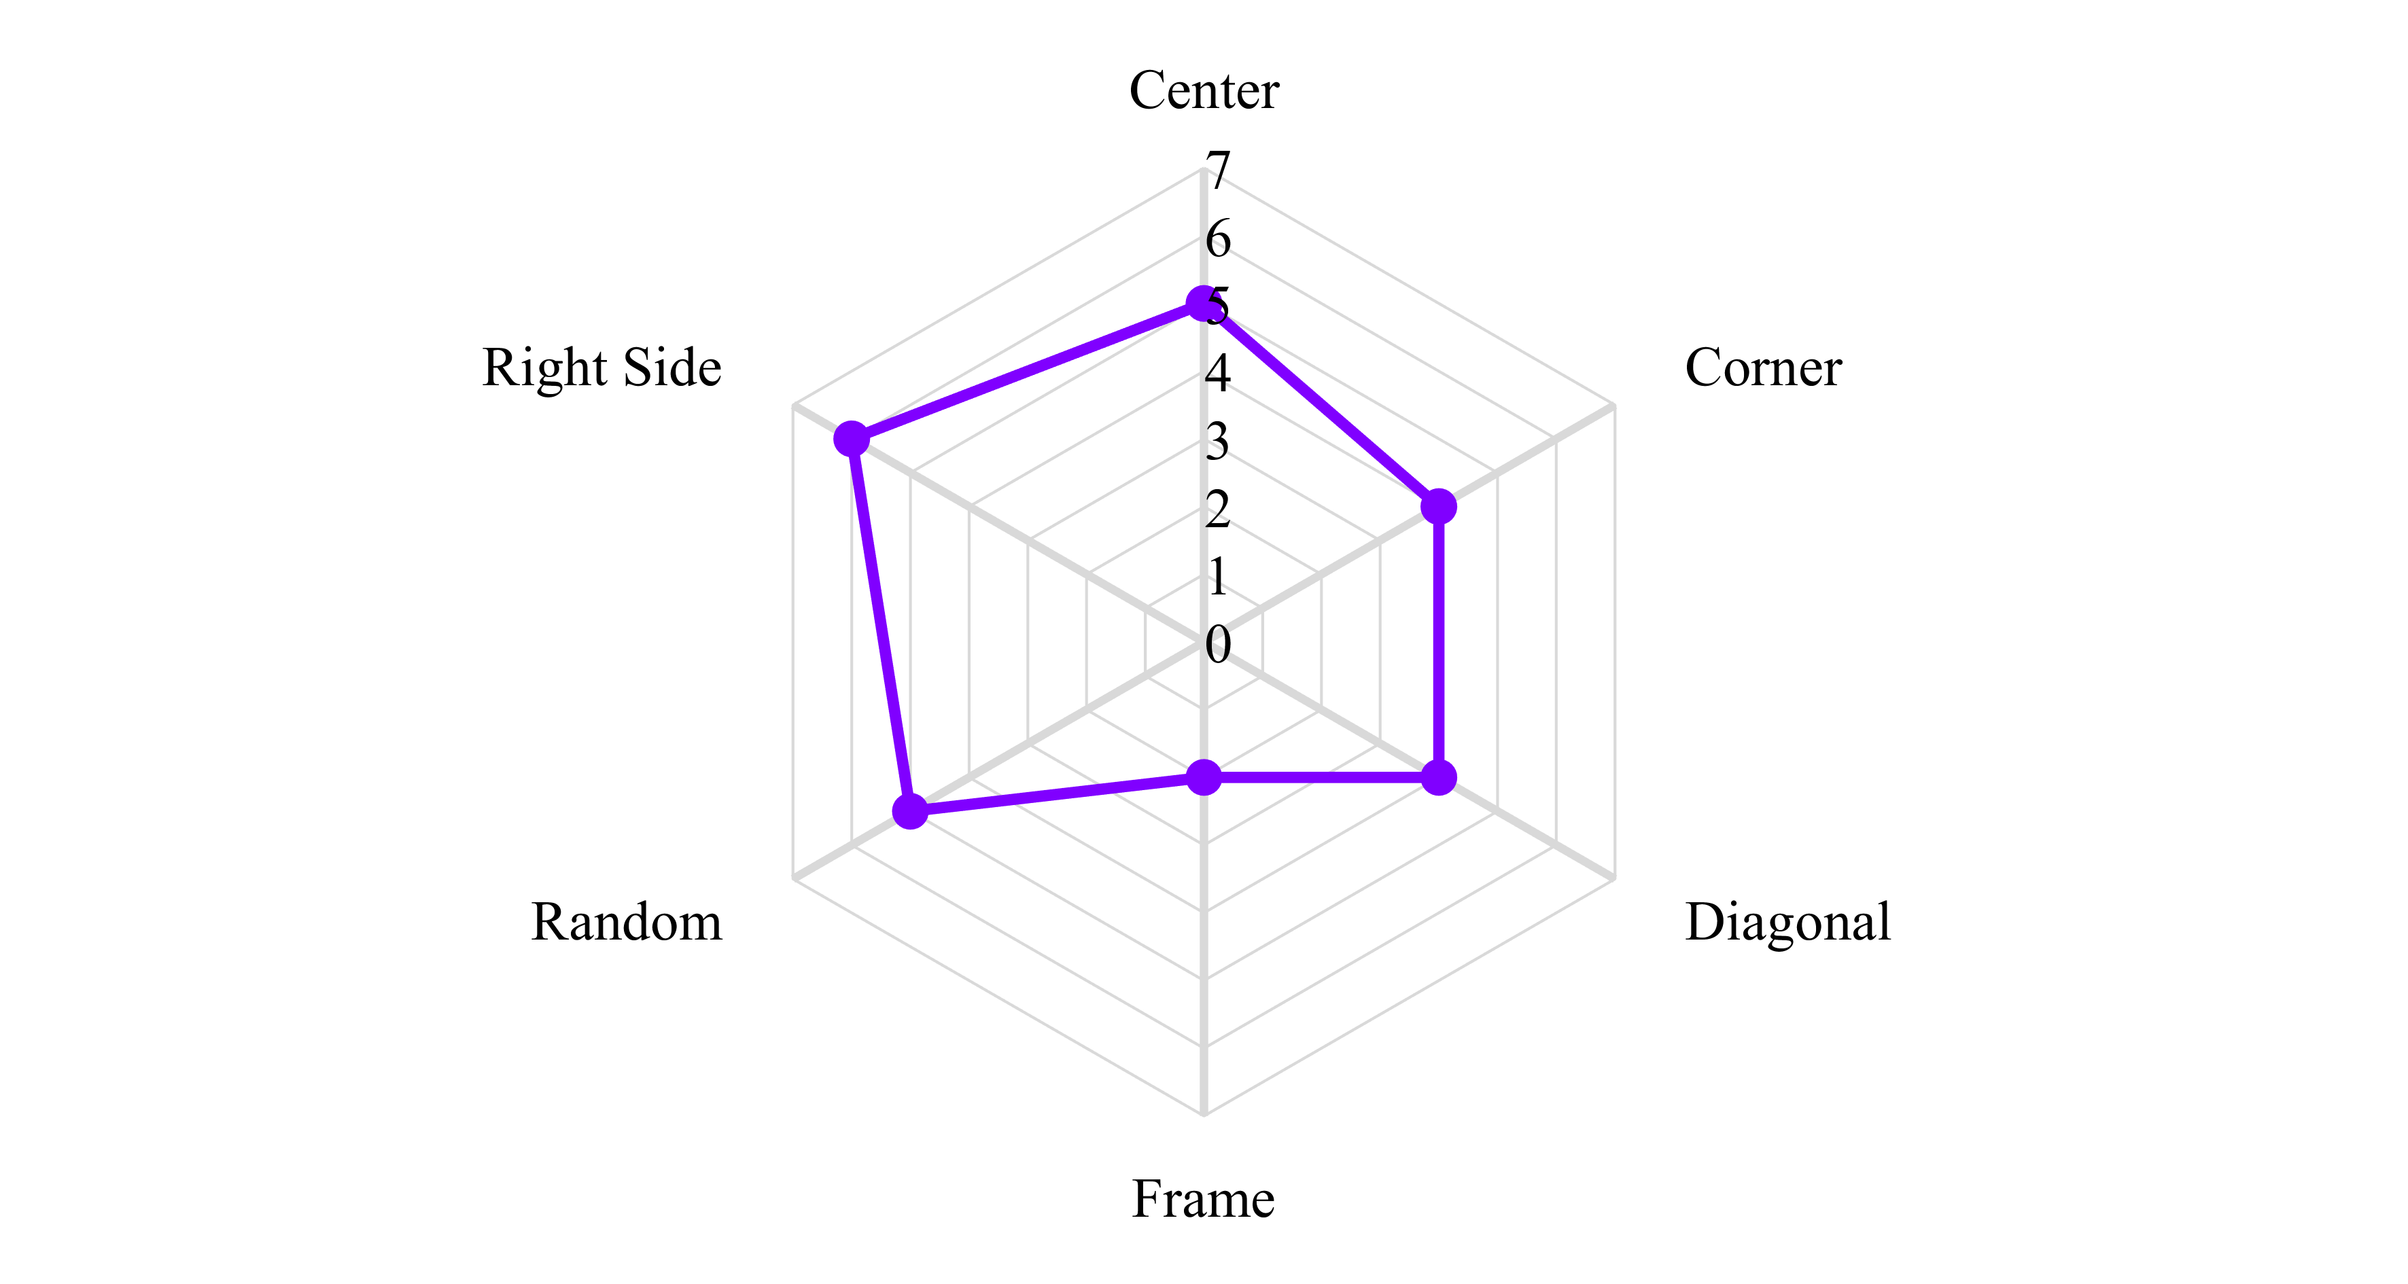
Global Maximum Power and Number of Local Maximum Power Points under Partial Shading Conditions
Global Maximum Powers of TCT PV Array under PSCs
Number of Local Maximum Power Points under PSCs

Slide 15
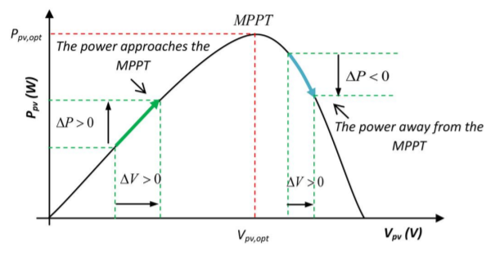
Maximum Power Point Tracking Algorithm
Perturbation and Observation (P&O)
It works with a perturbation in the voltage and the change in its output power is observed. It need the direction of the perturbation and the corresponding change in power occurred with that perturbation, if the perturbation leads to increase in output power, the voltage is further increased, otherwise the voltage is decreased. The direction is found if dP/dV > 0 then is left of MPP, if dP/dV = 0 then is a MPP and if dP/dV < 0 is right of MPPT.

Slide 16
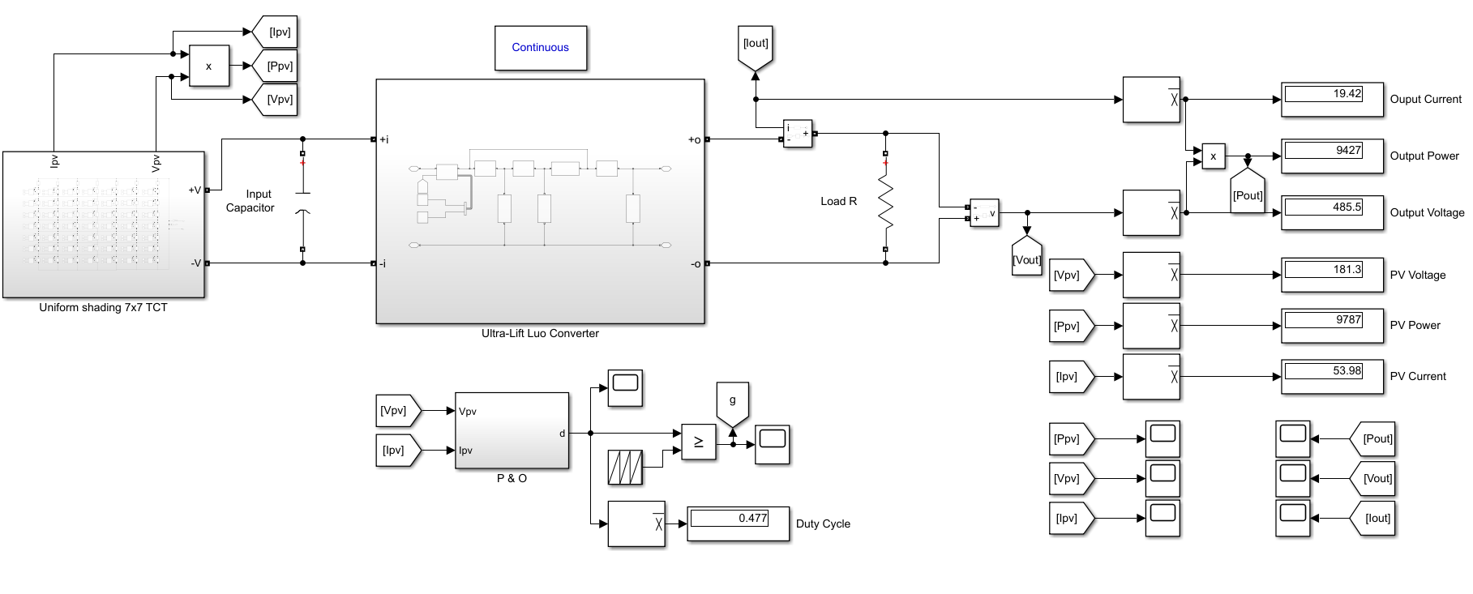
Simulation Model
1

Slide 17
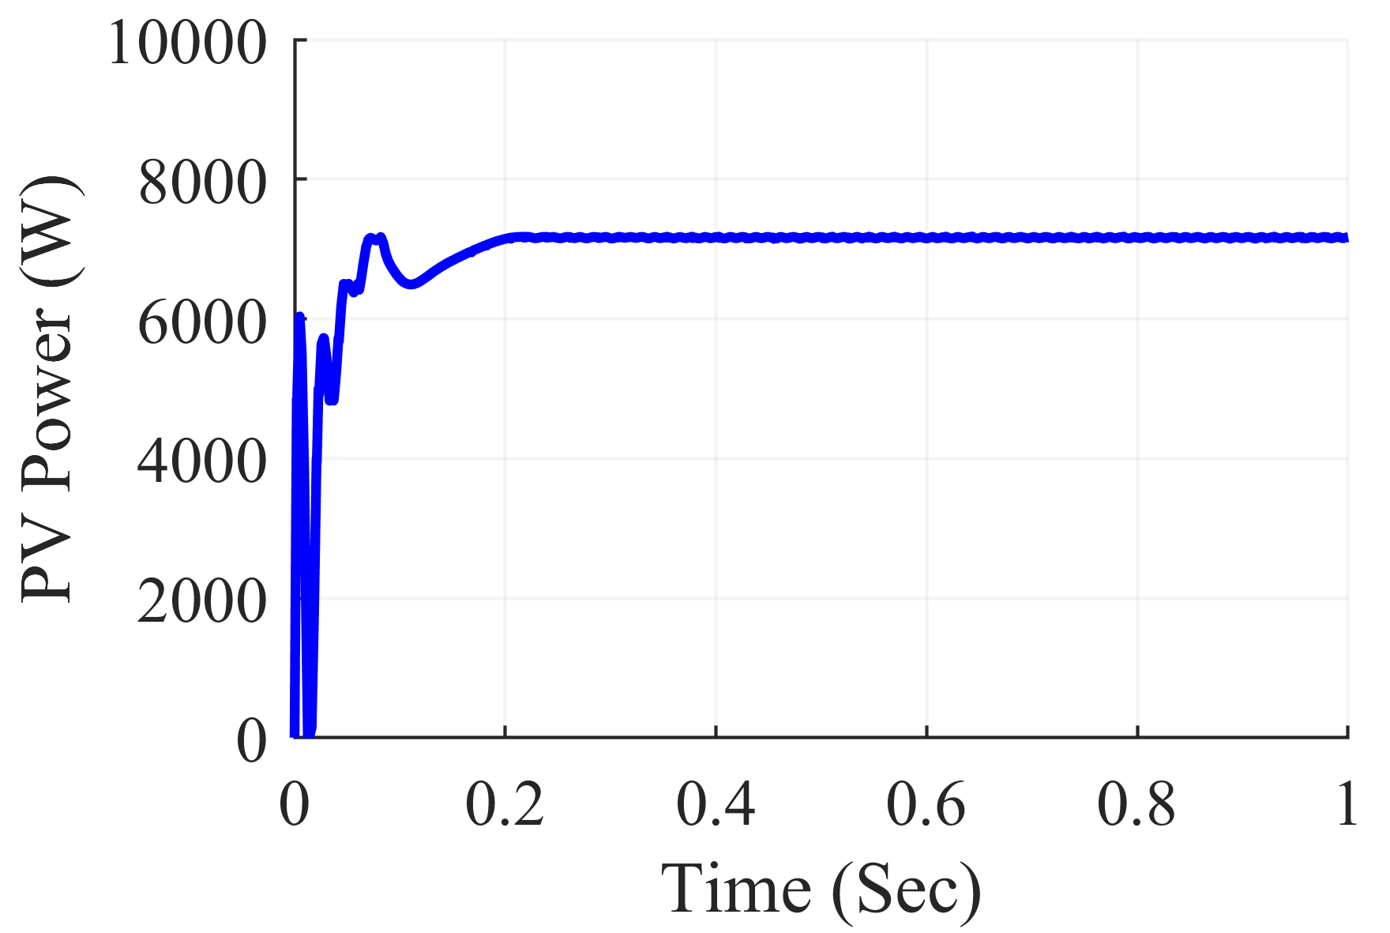
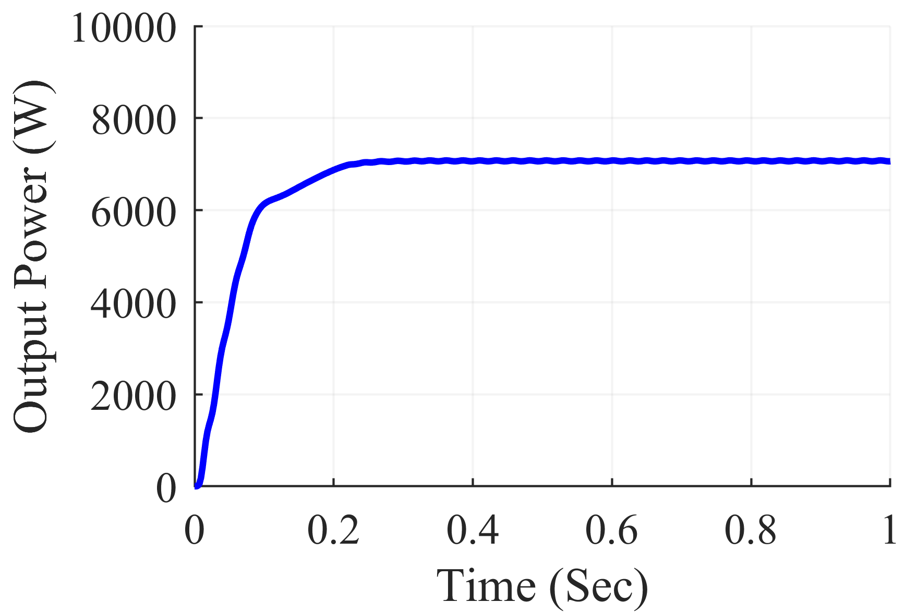
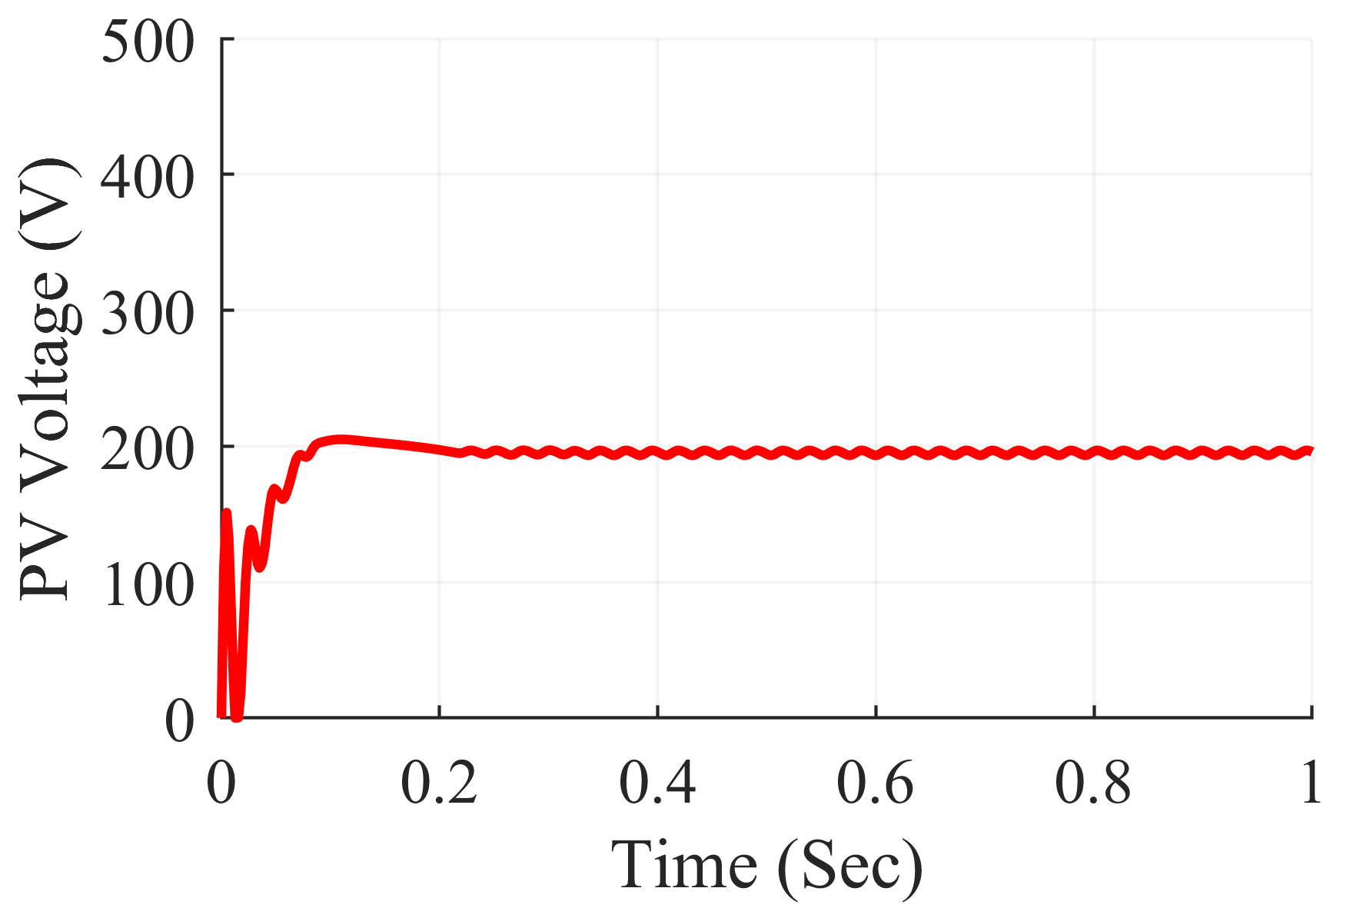
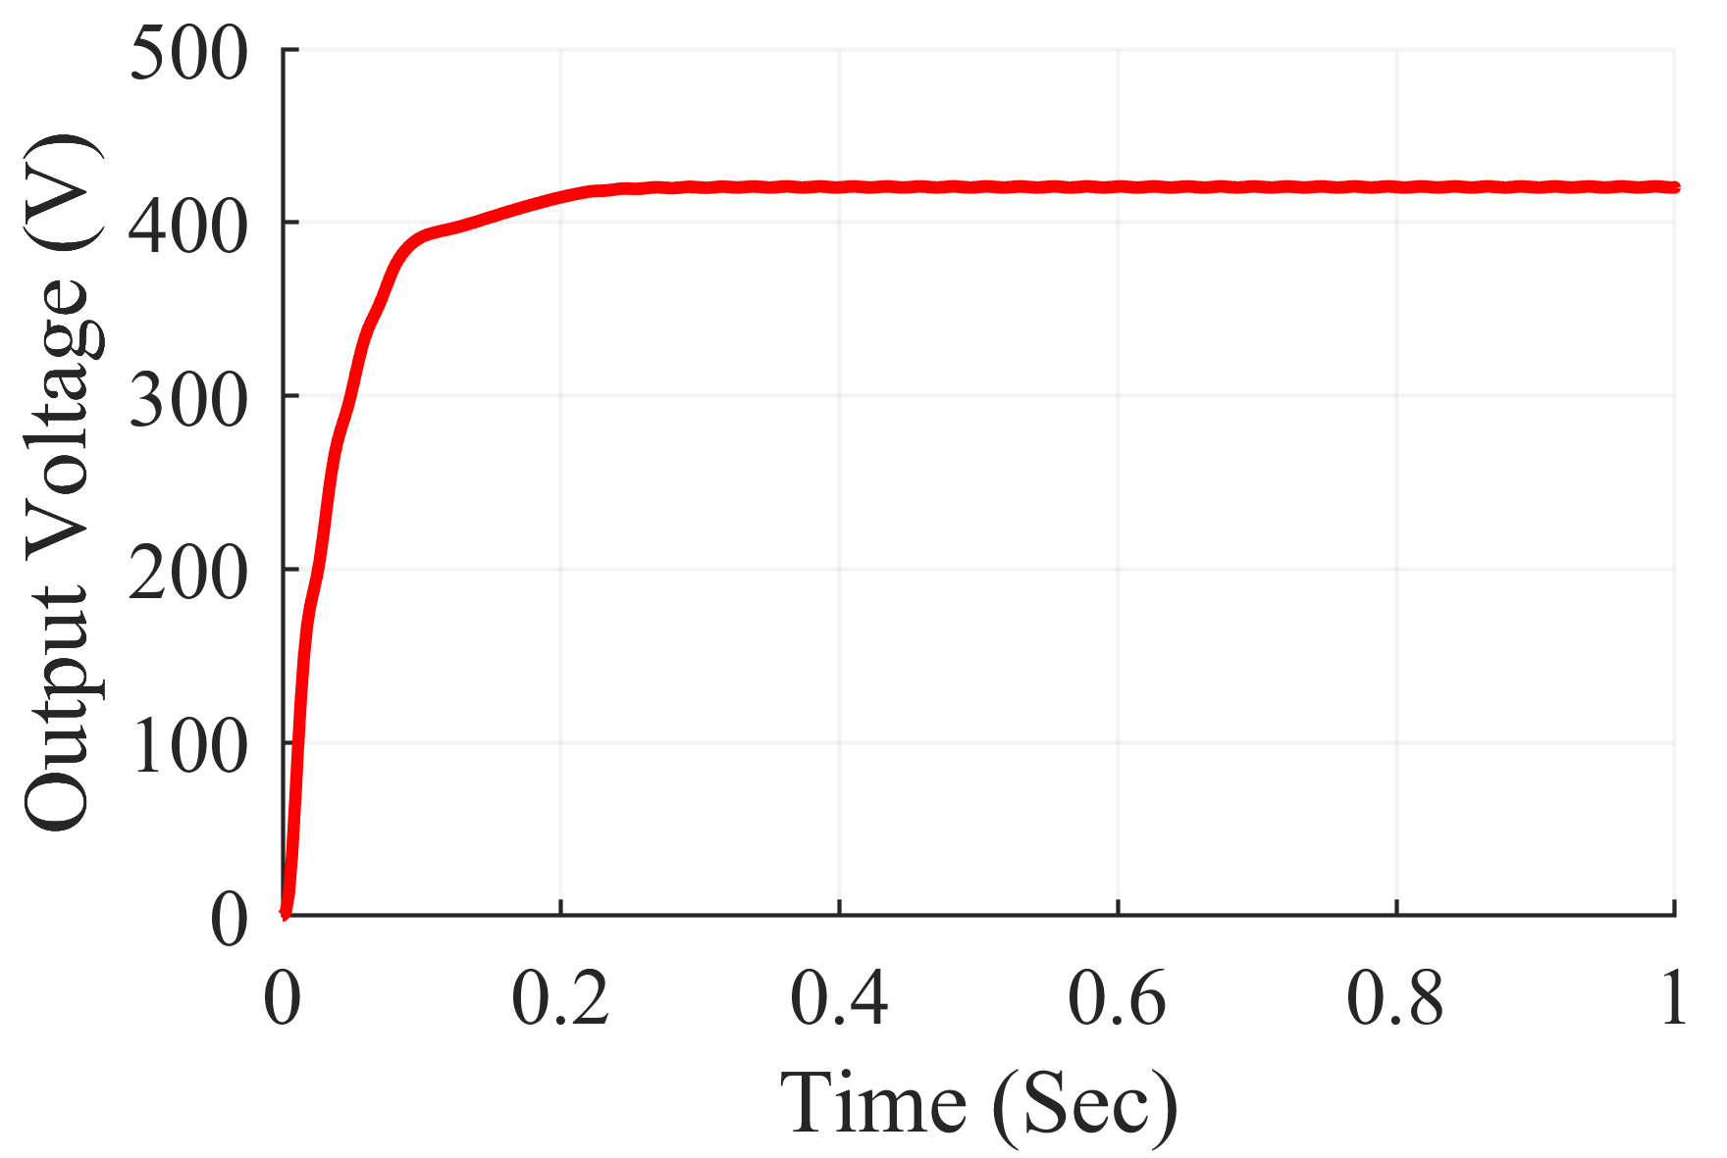
Simulation Results
Input and Output Power and Voltage Boost Converter under Center Shading Scenario

Slide 18
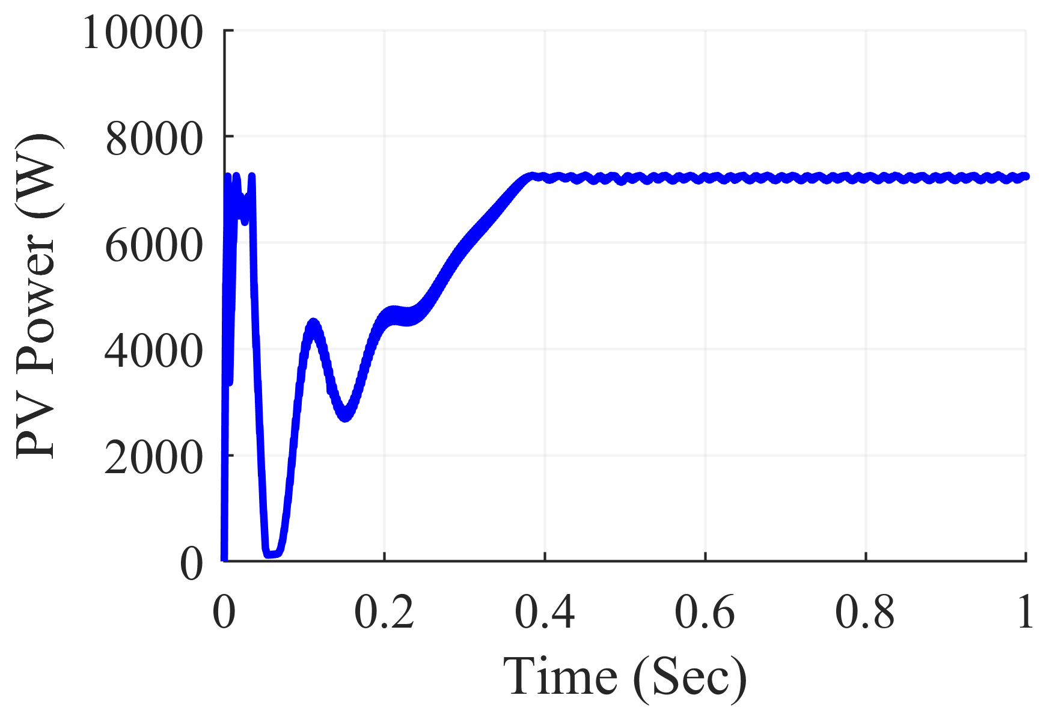
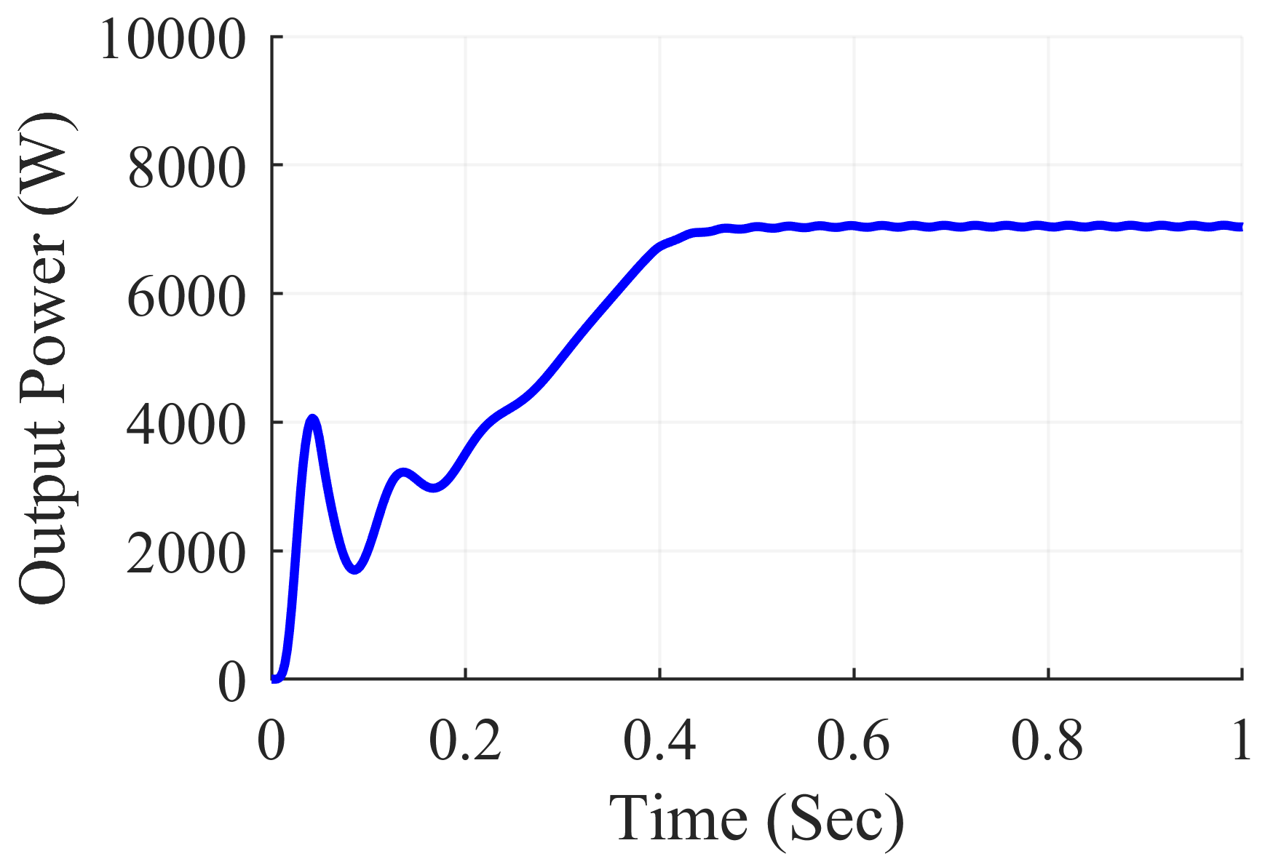
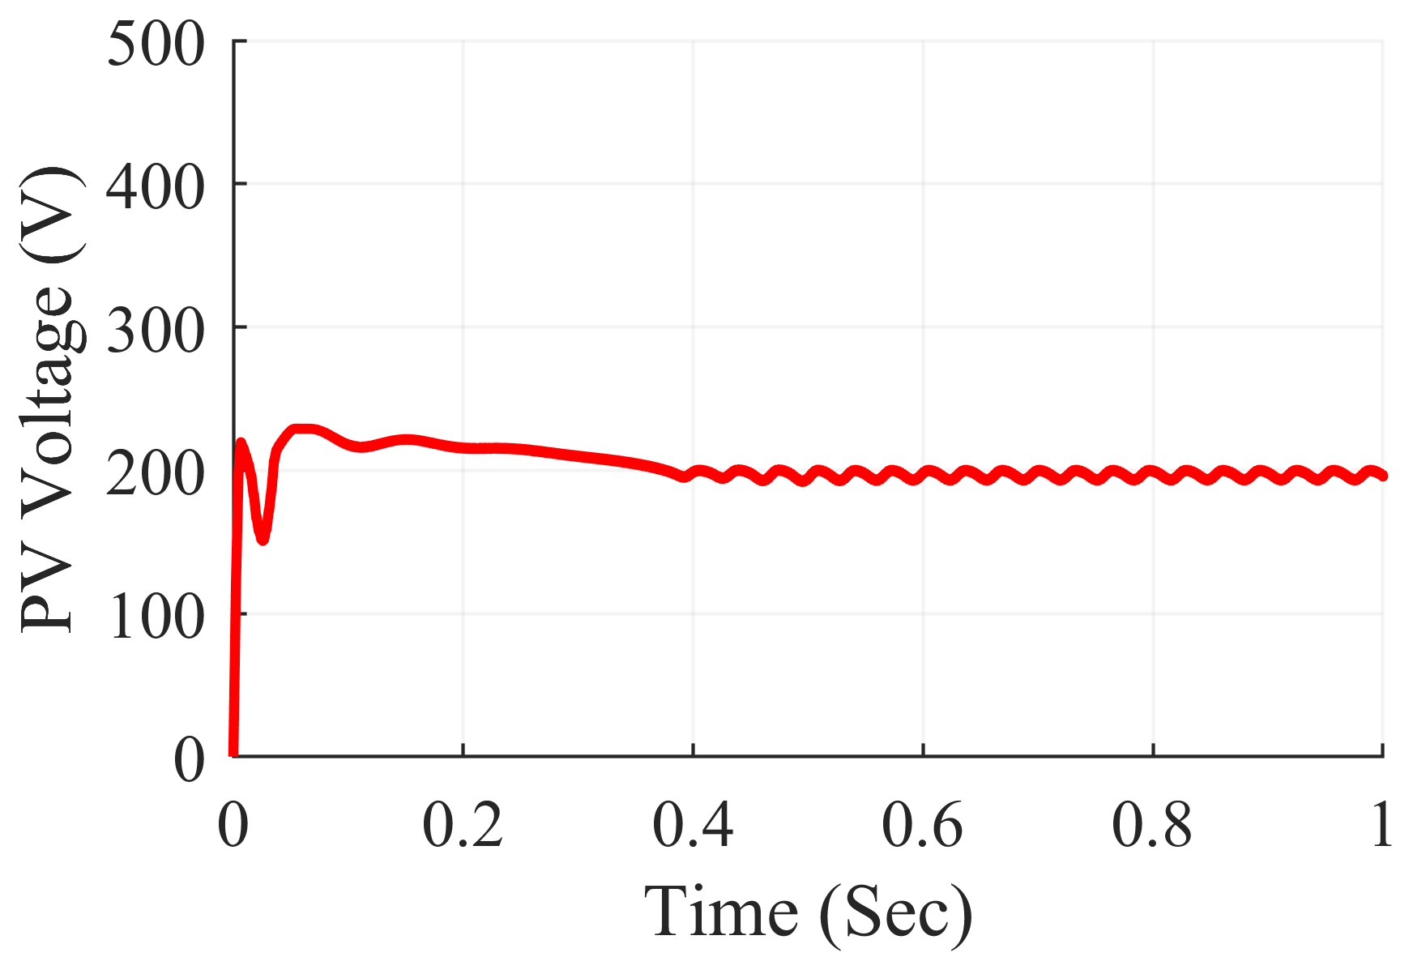
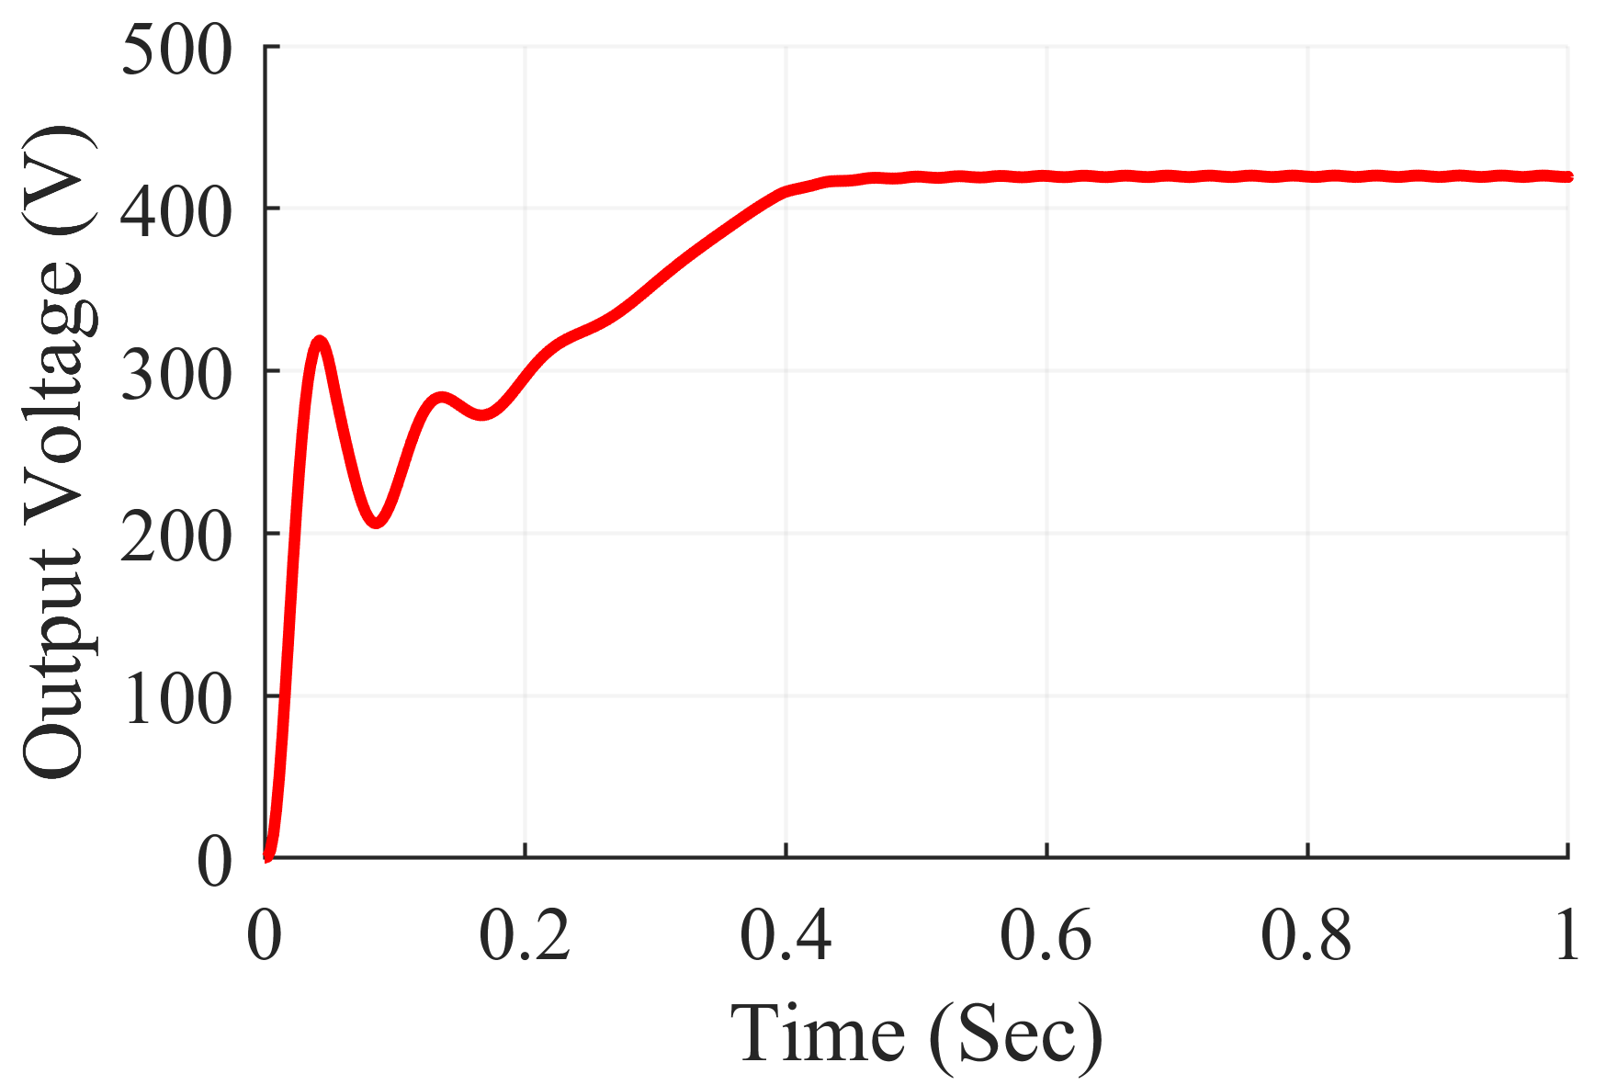
Simulation Results
Input and Output Power and Voltage Buck-Boost Converter under Corner Shading Scenario

Slide 19
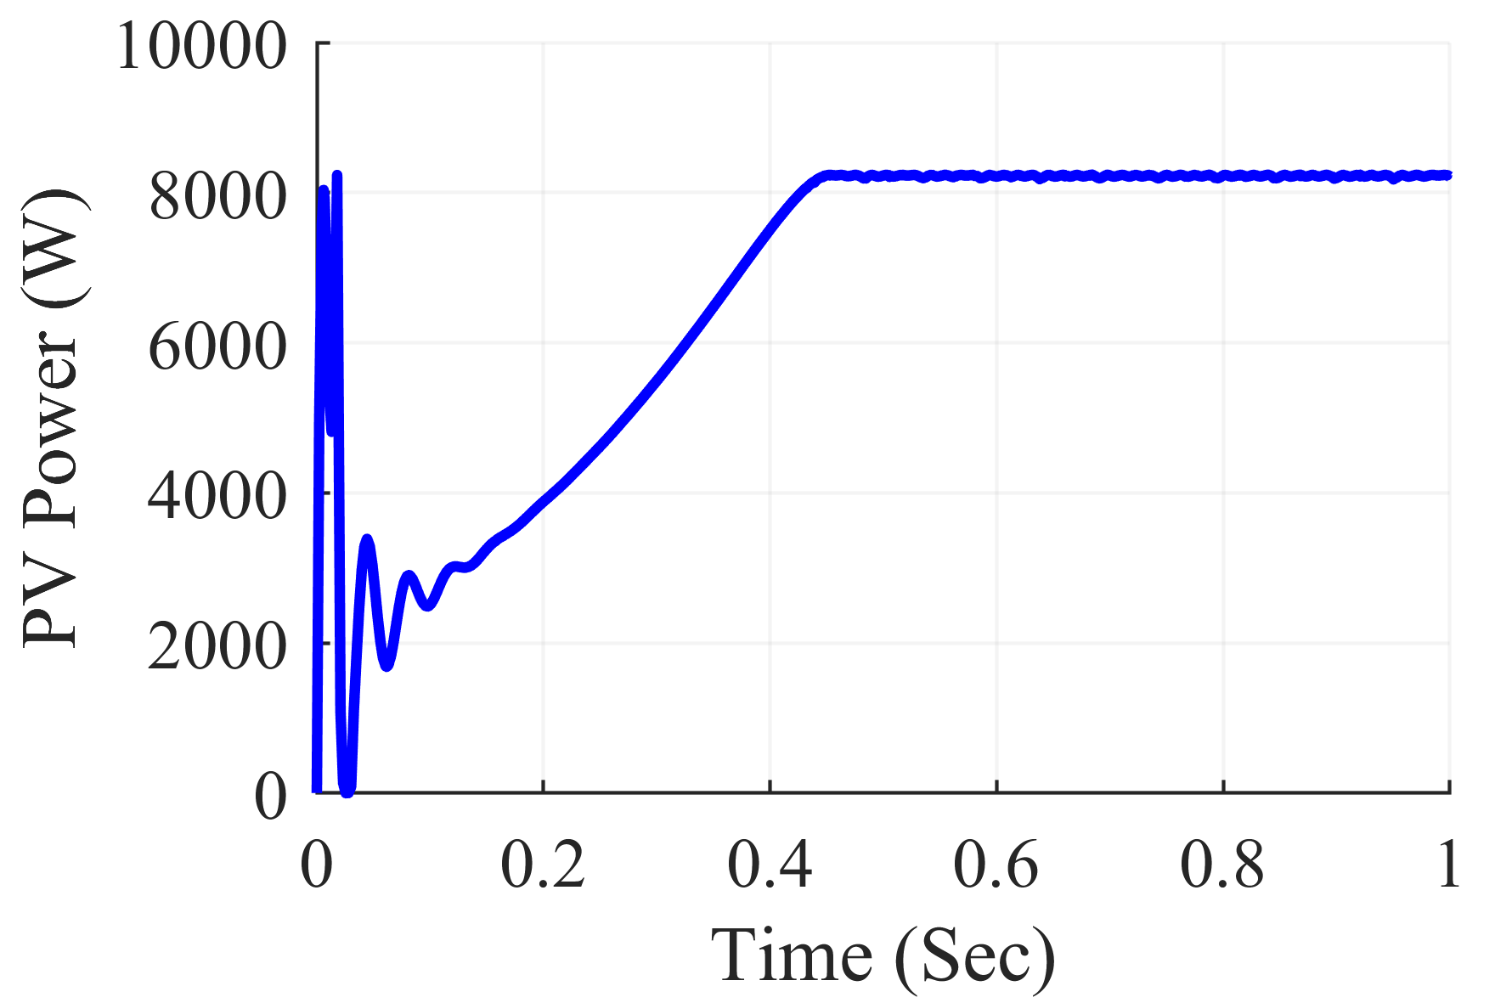
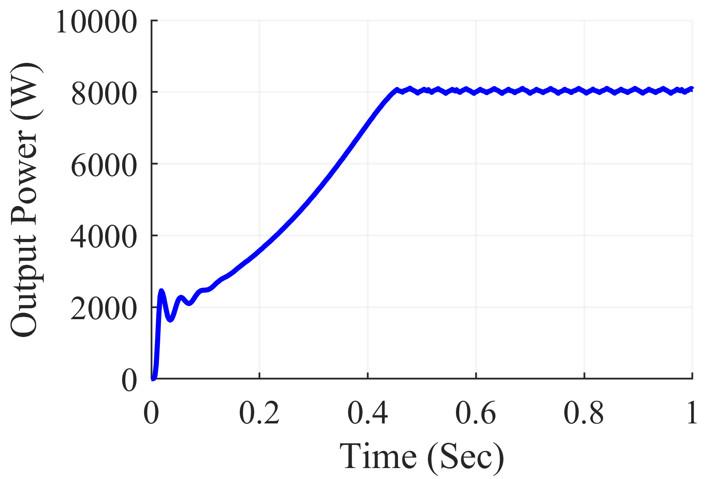
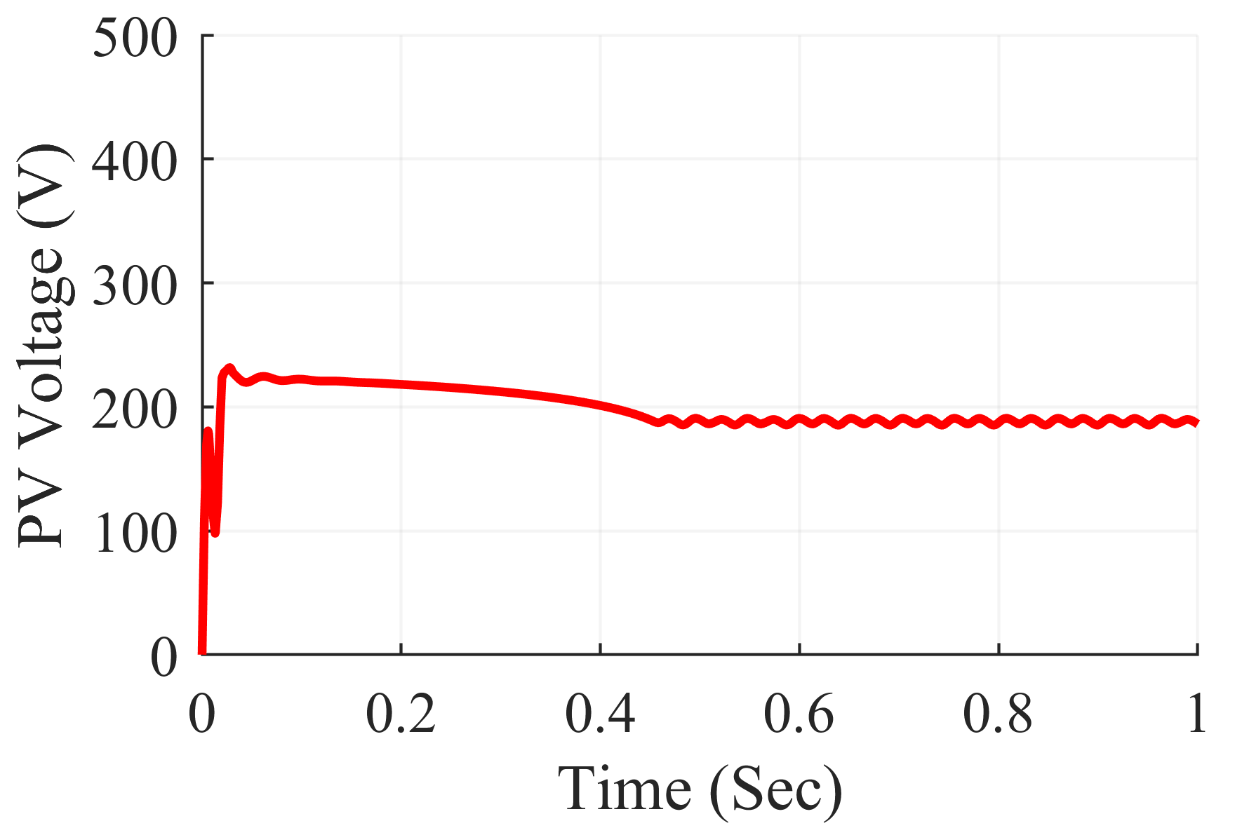
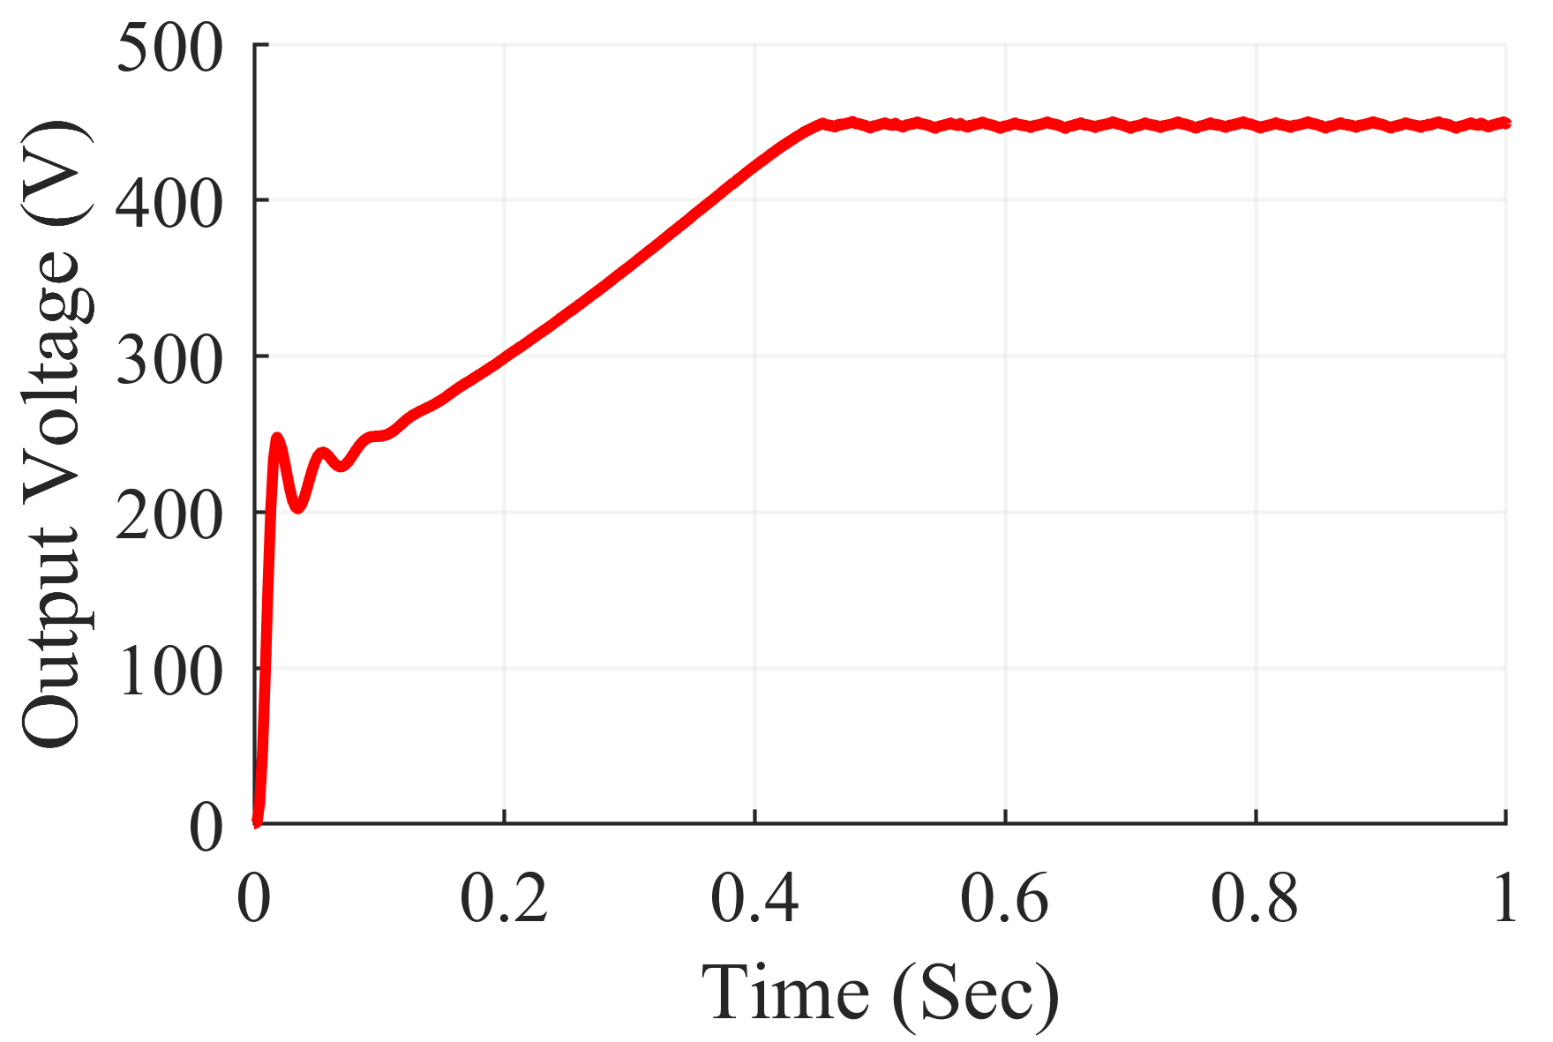
Simulation Results
Input and Output Power and Voltage Cuk Converter under Diagonal Shading Scenario

Slide 20
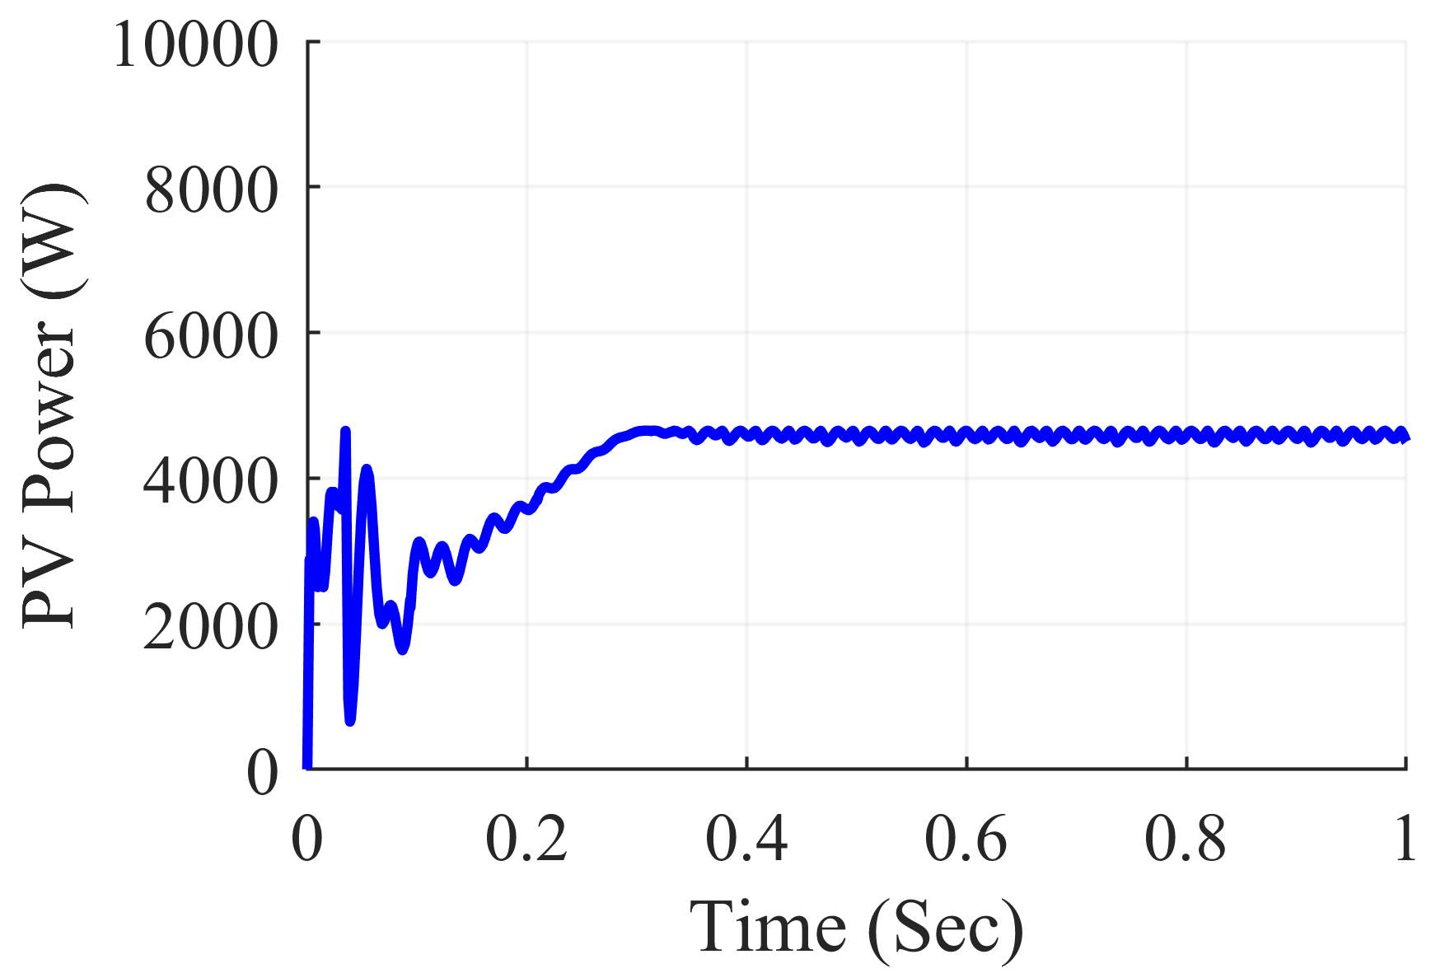
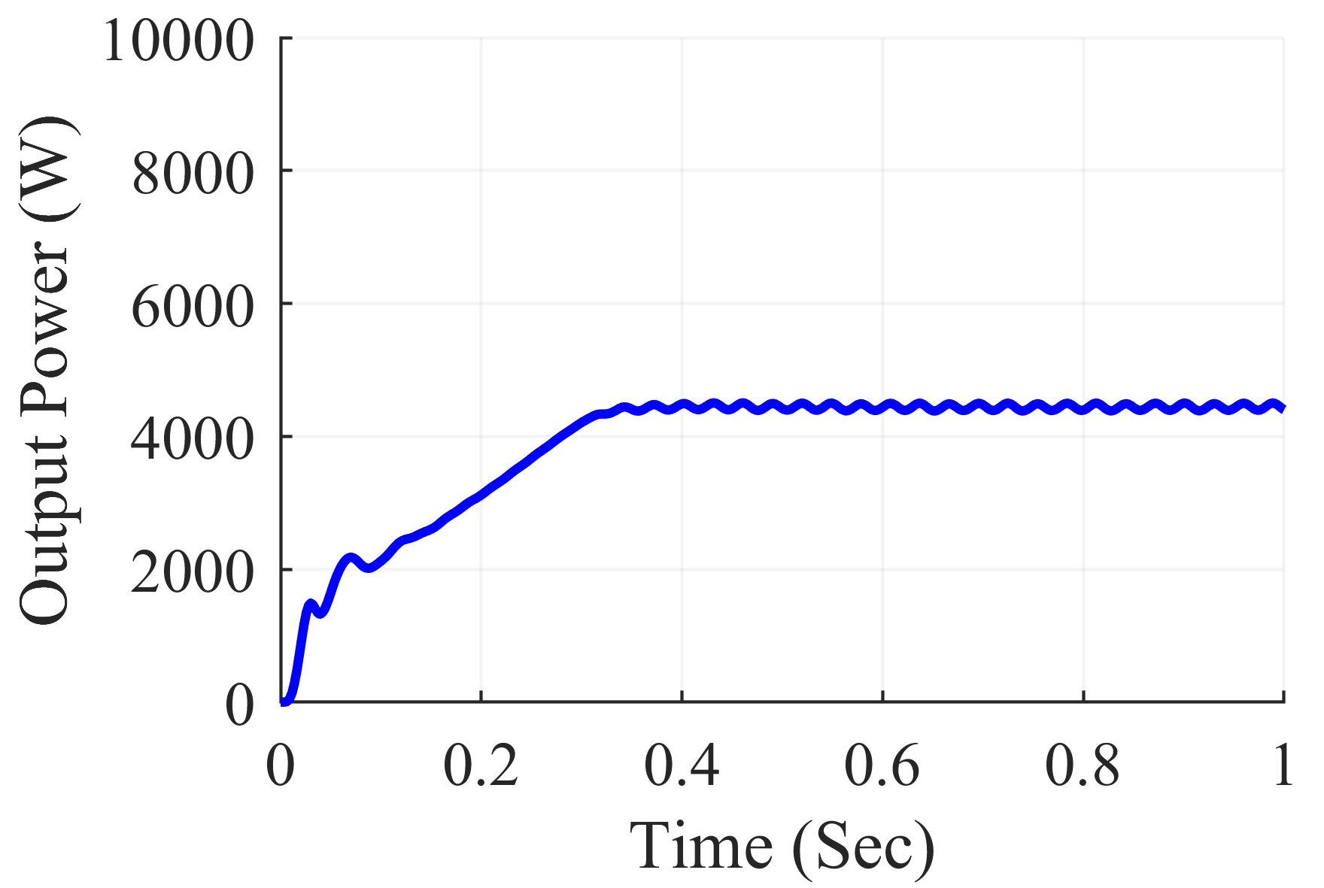
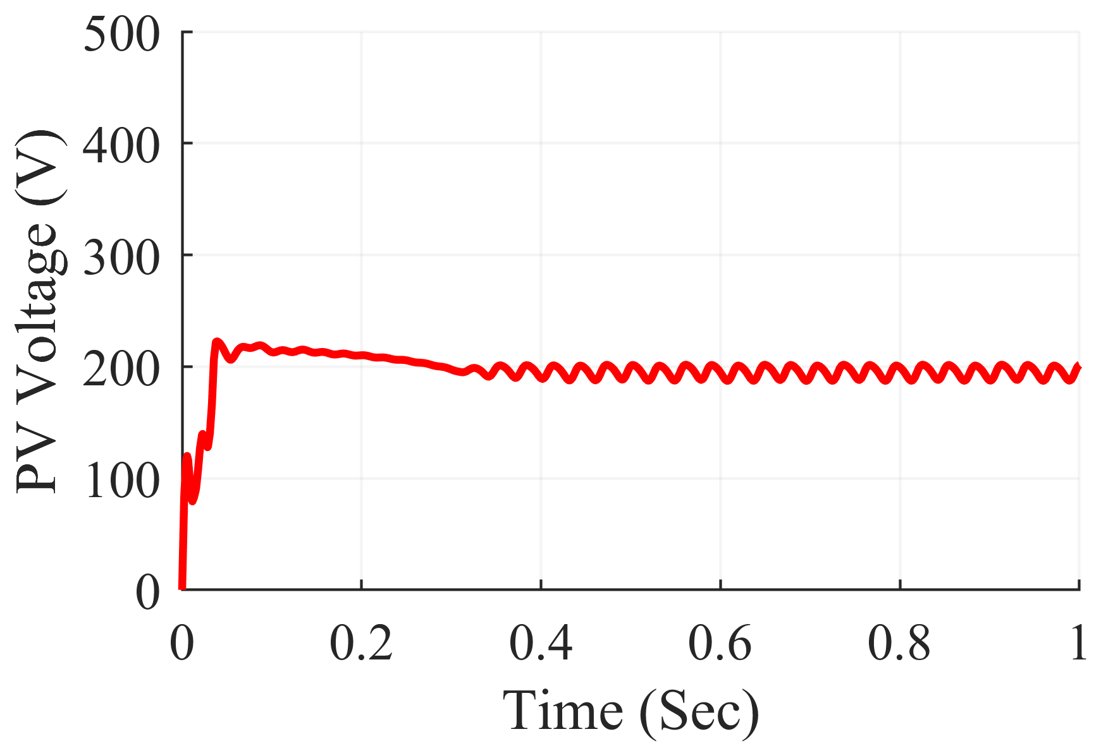
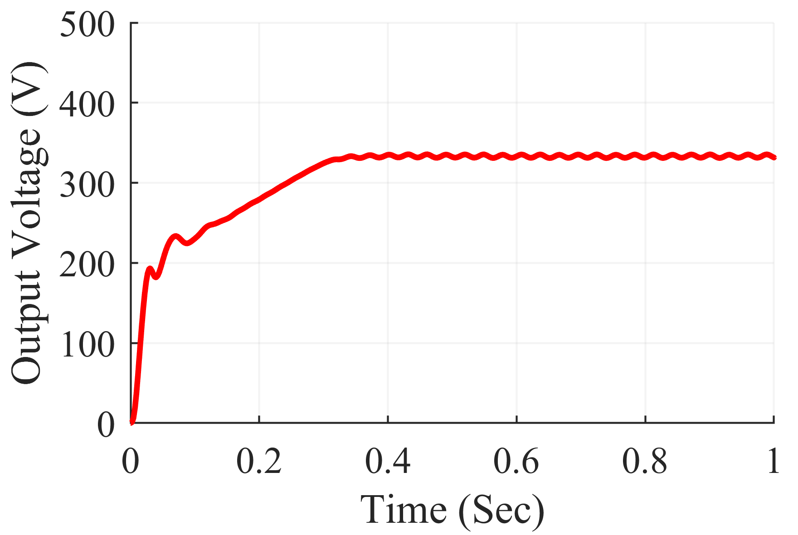
Simulation Results
Input and Output Power and Voltage SEPIC Converter under Frame Shading Scenario

Slide 21
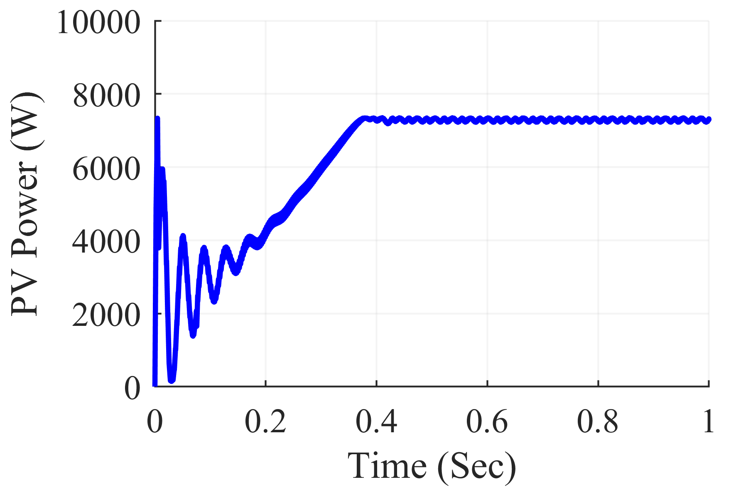
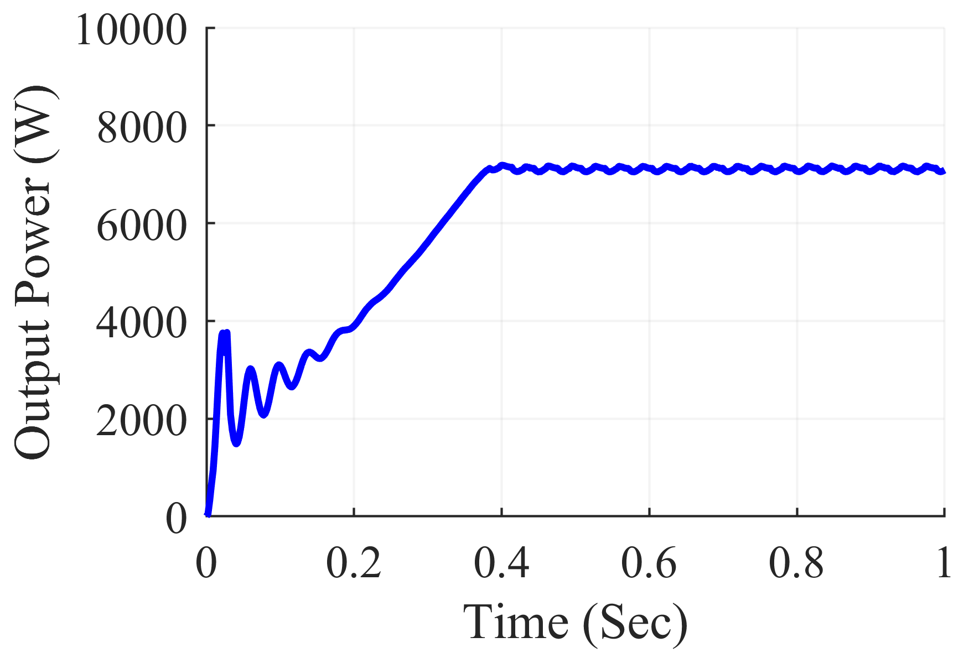
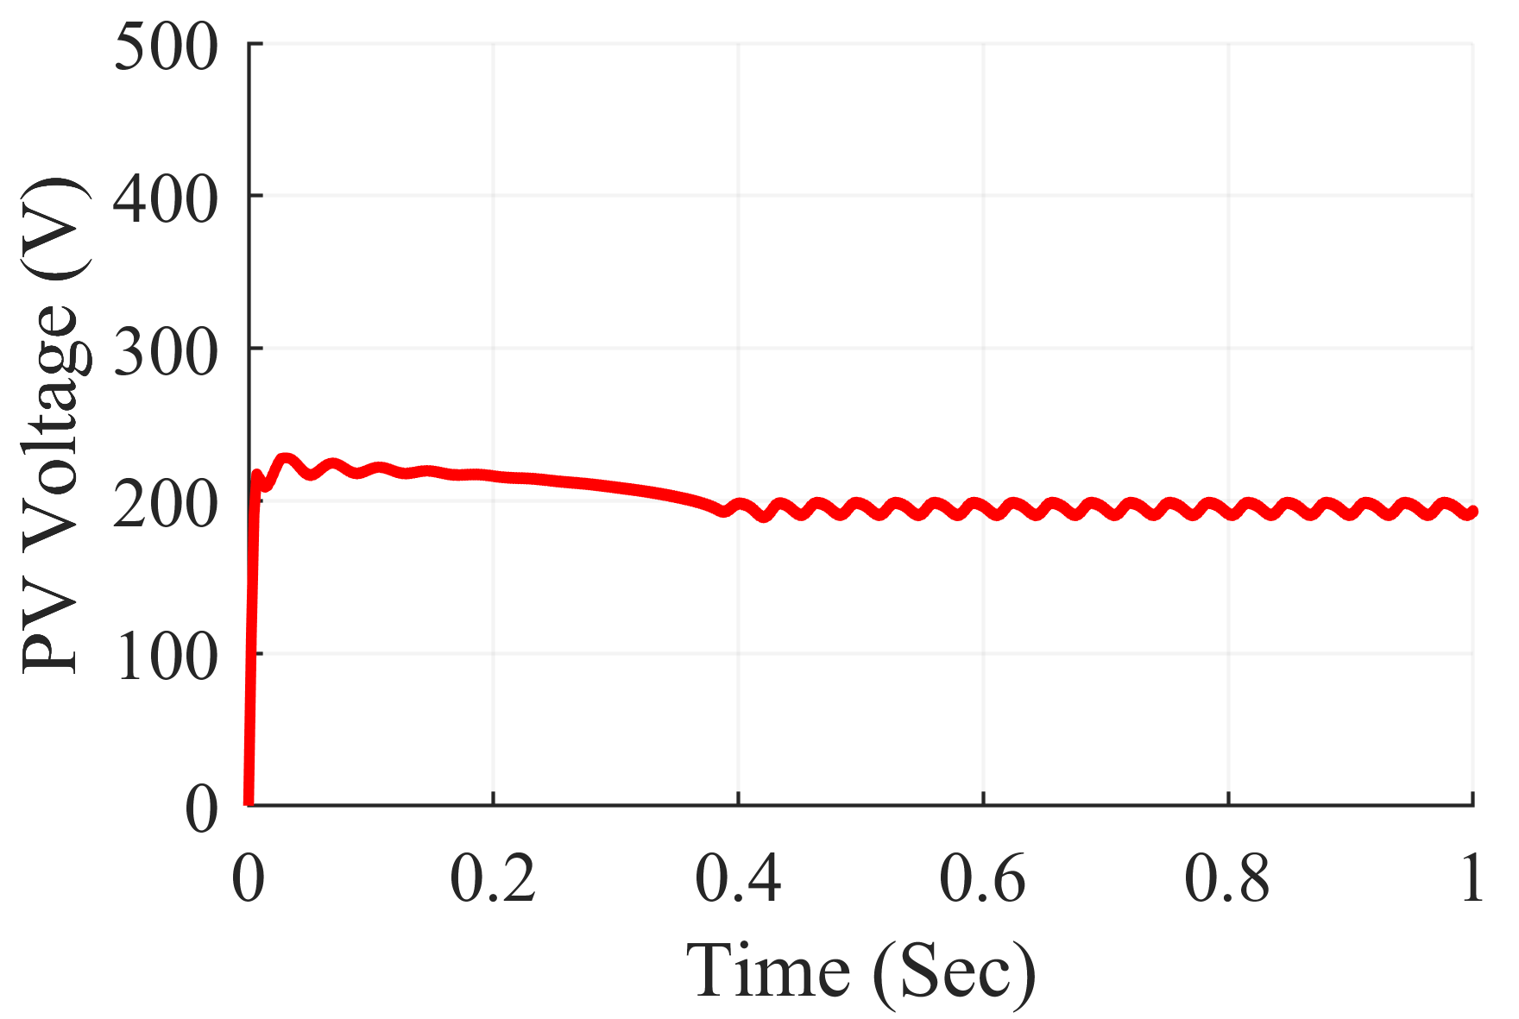
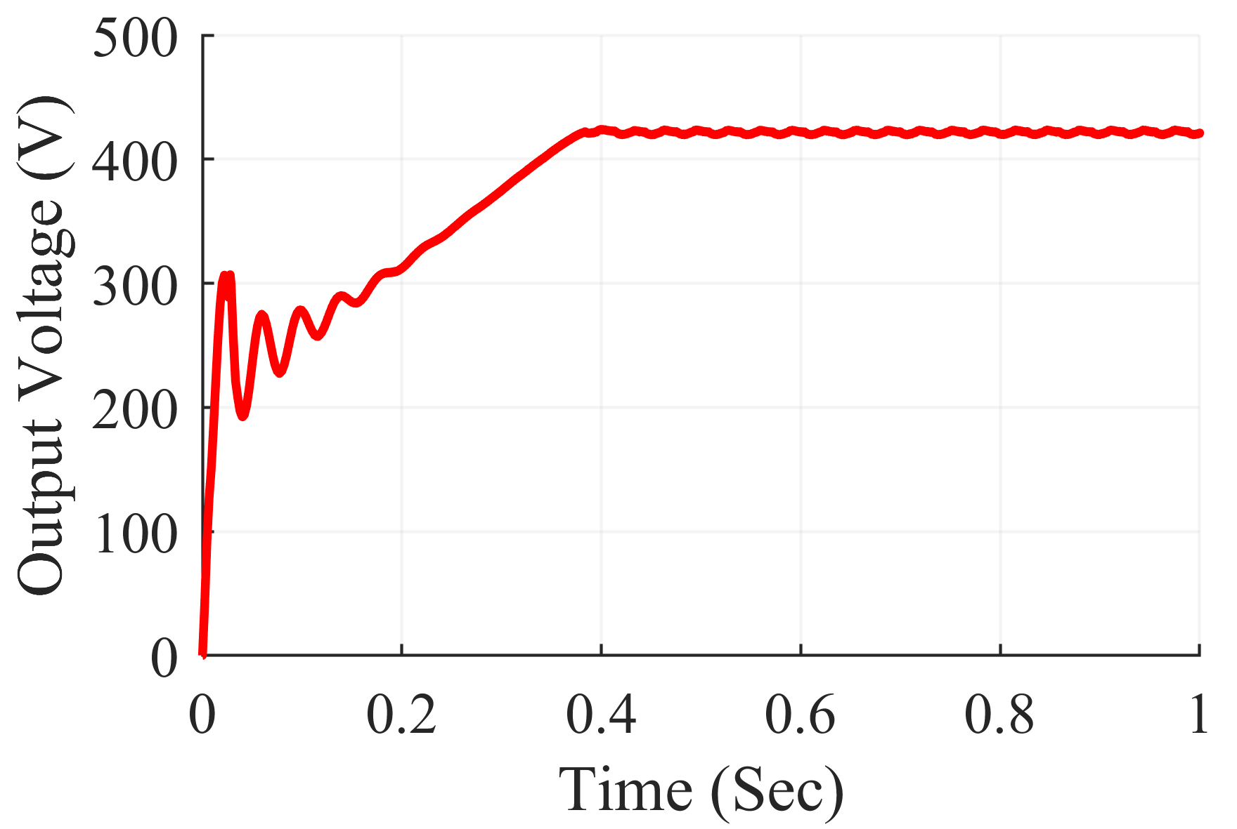
Simulation Results
Input and Output Power and Voltage Zeta Converter under Random Shading Scenario

Slide 22
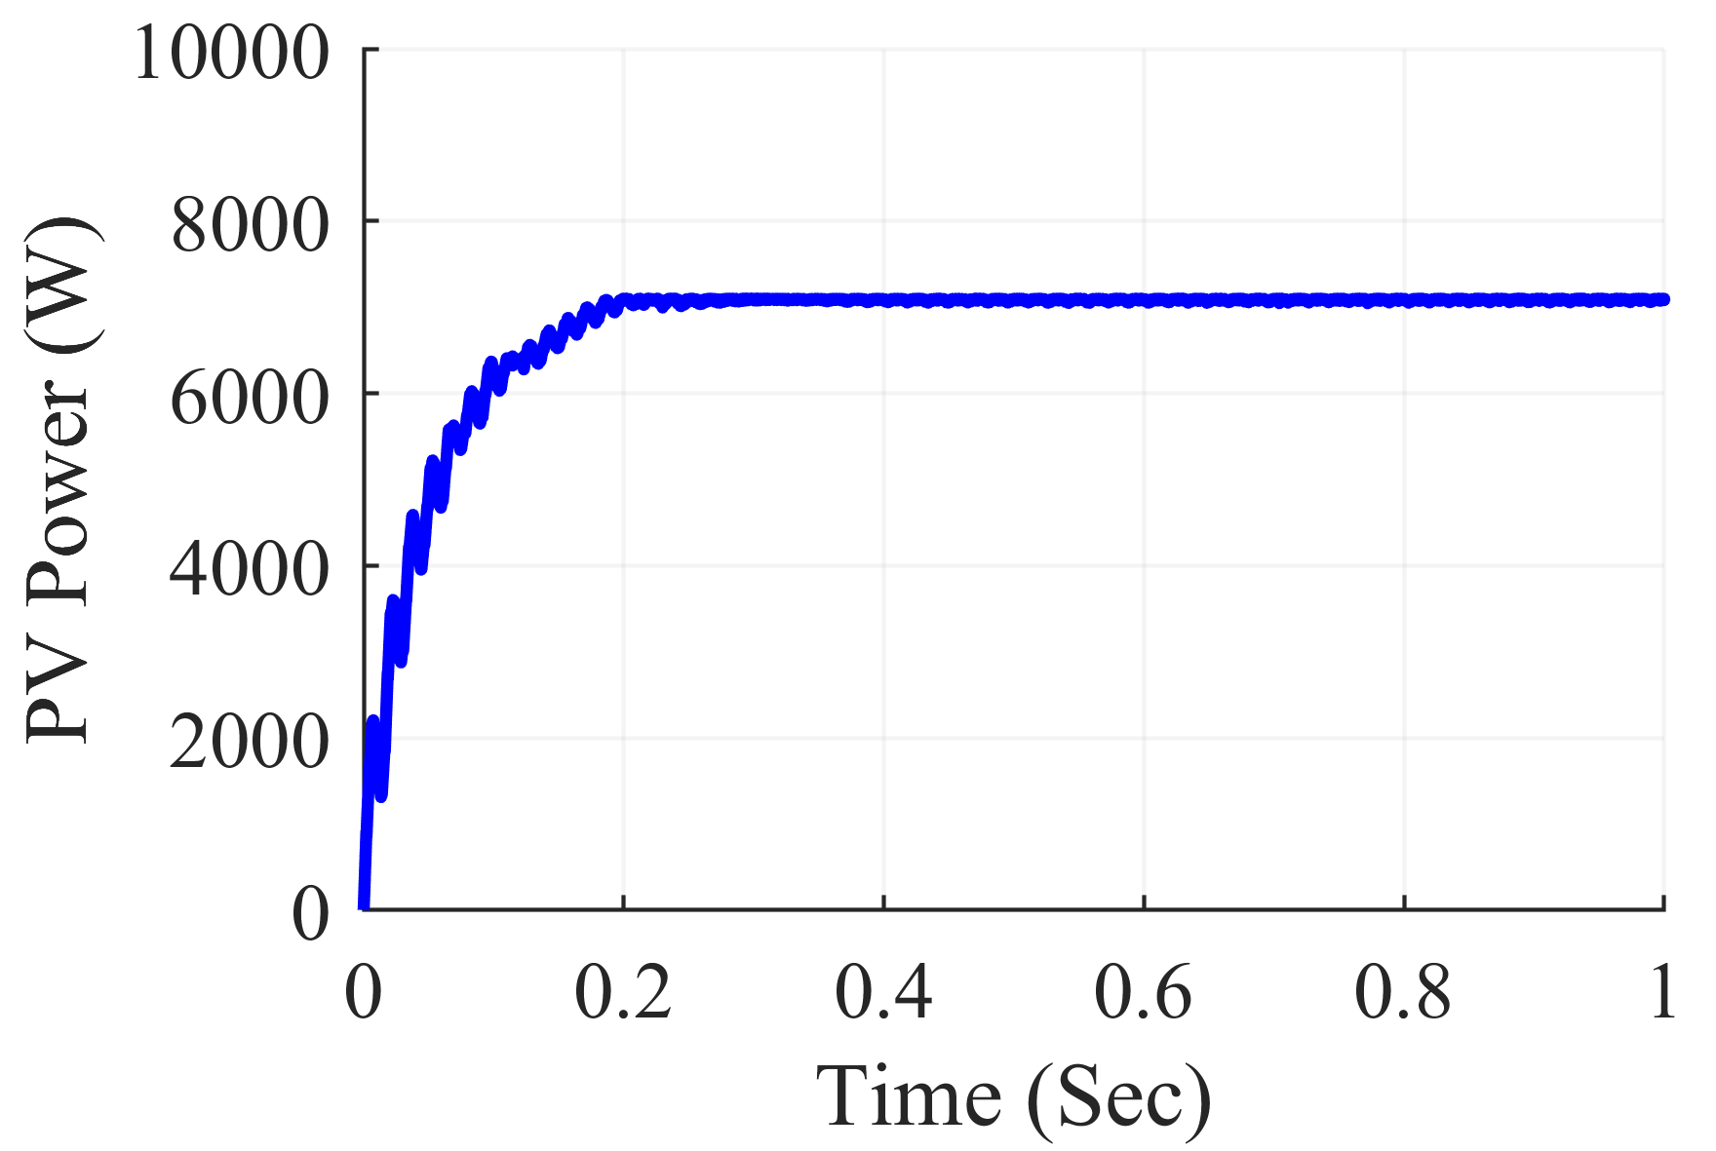
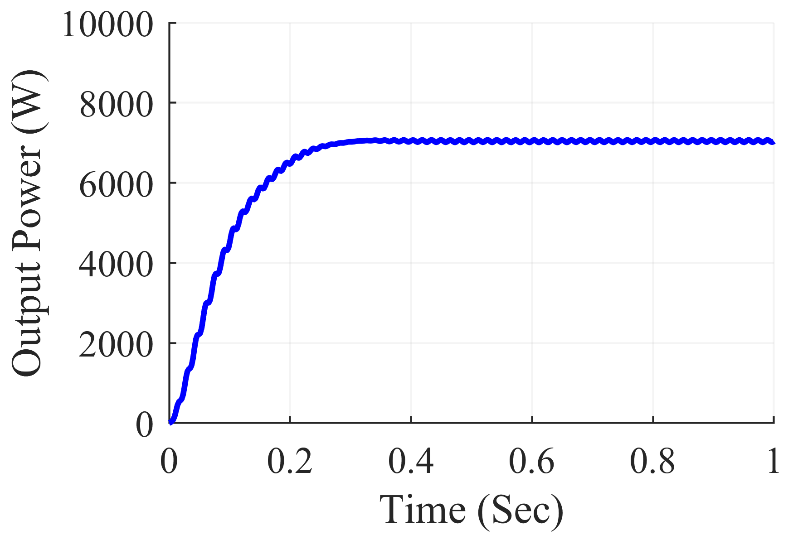
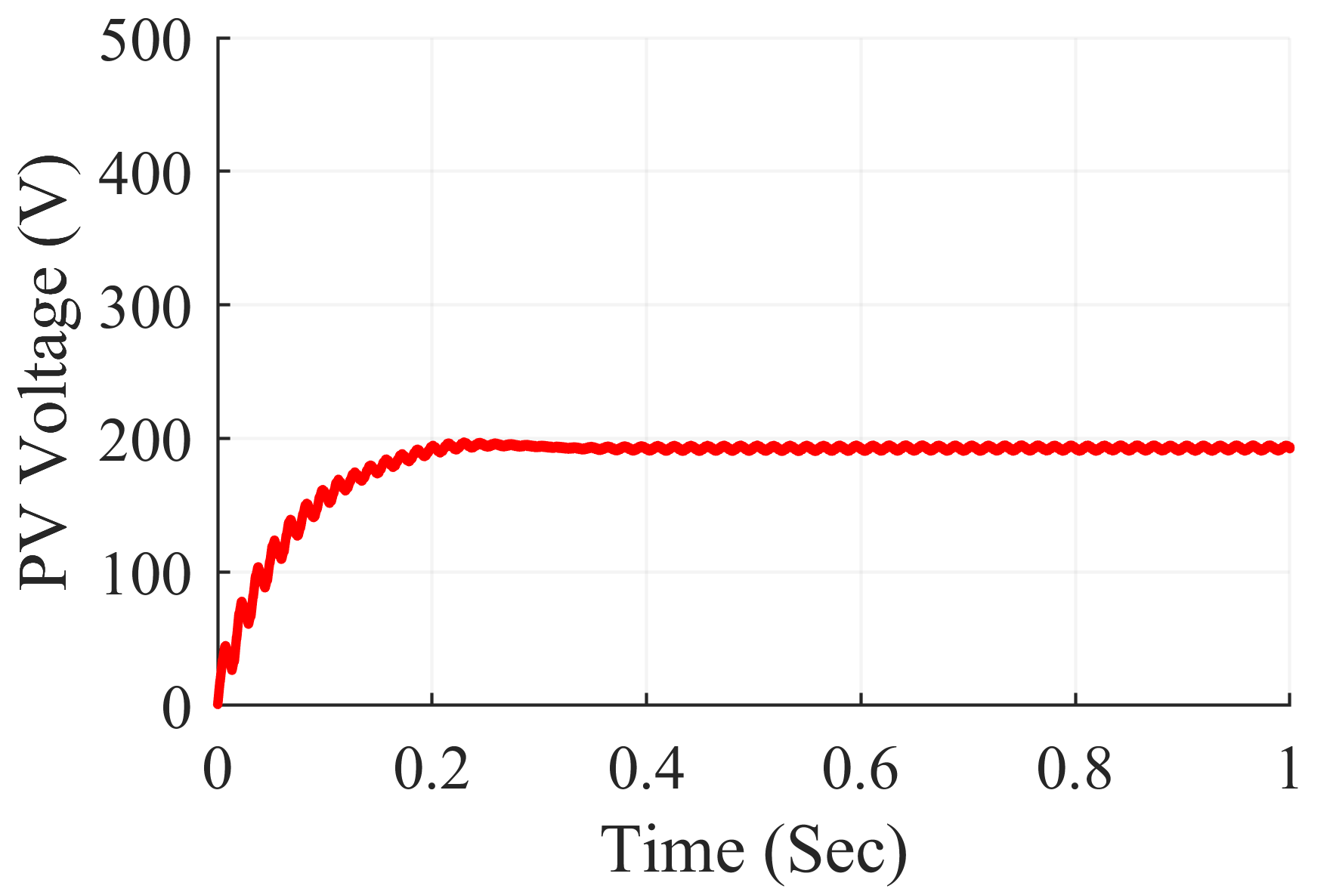
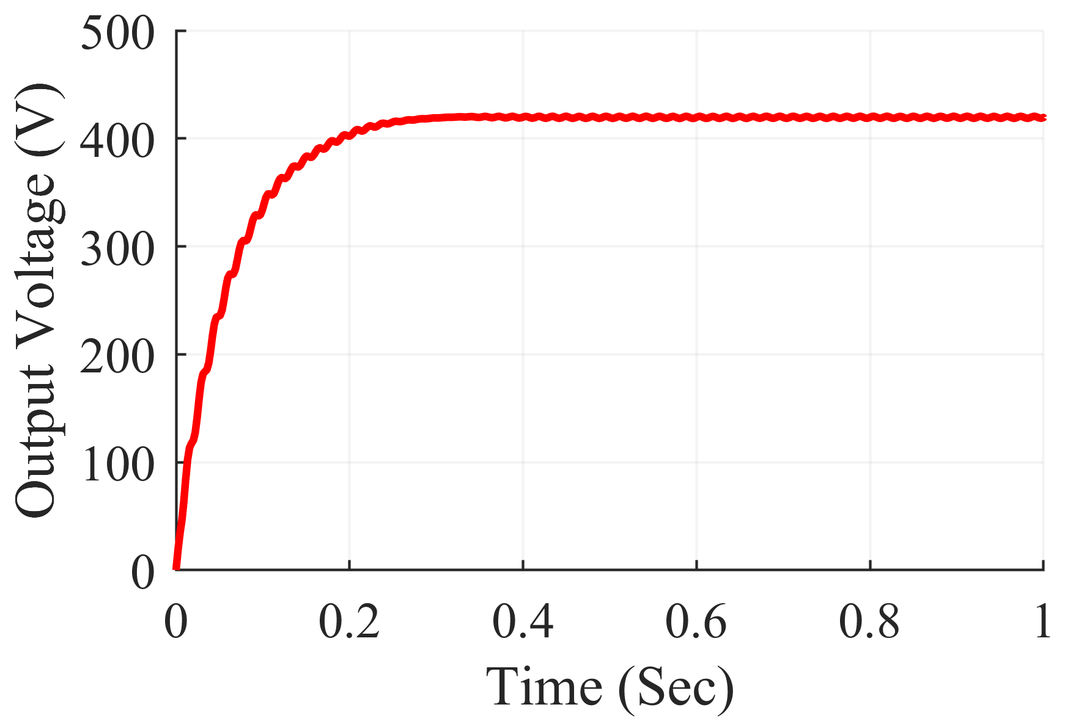
Simulation Results
Input and Output Power and Voltage Super-Lift Luo Converter under Random Shading Scenario

Slide 23
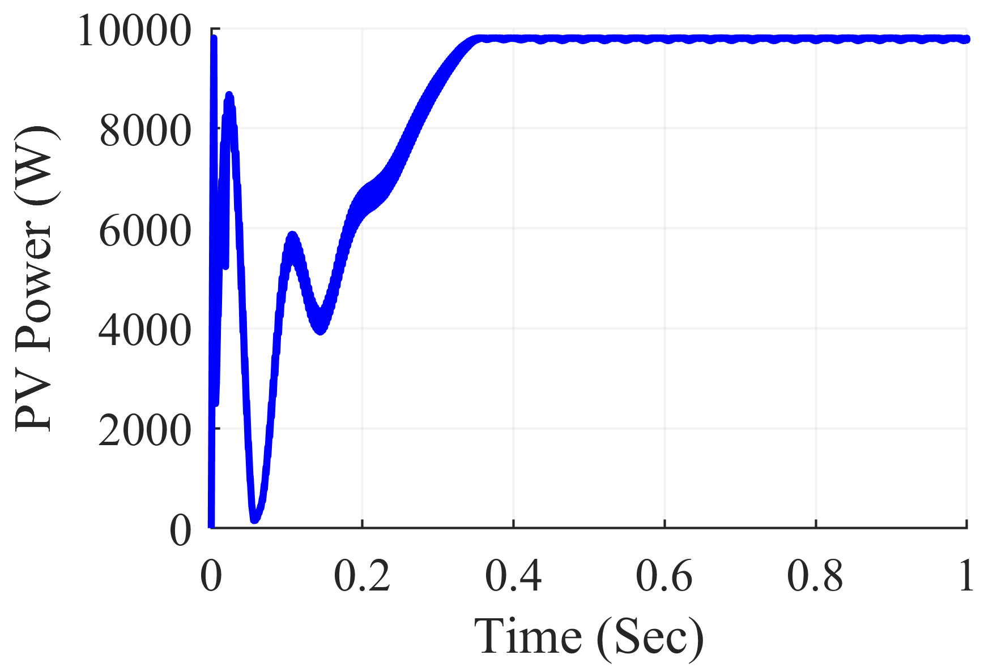
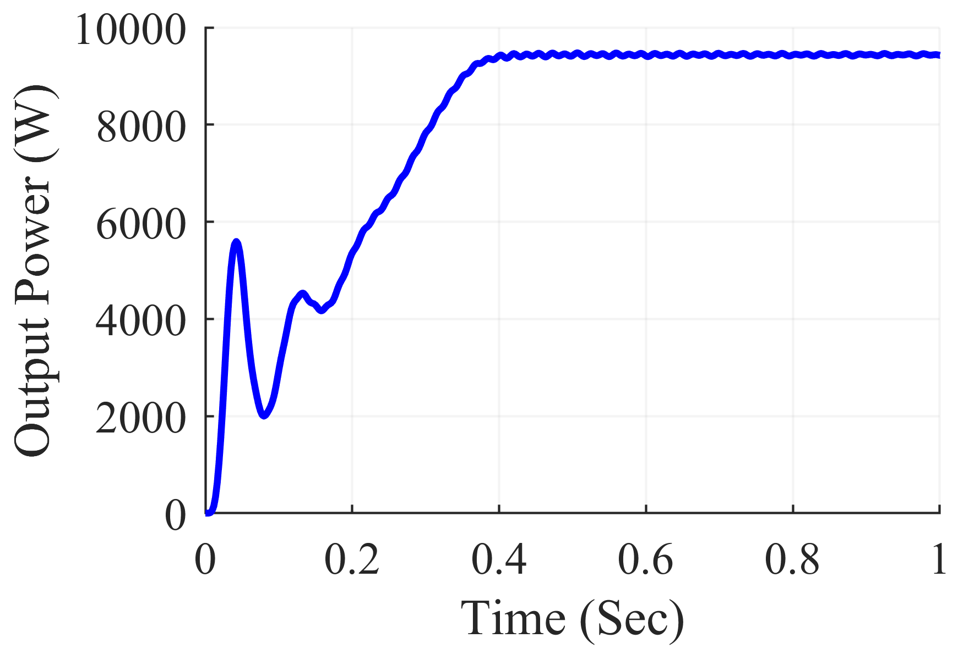
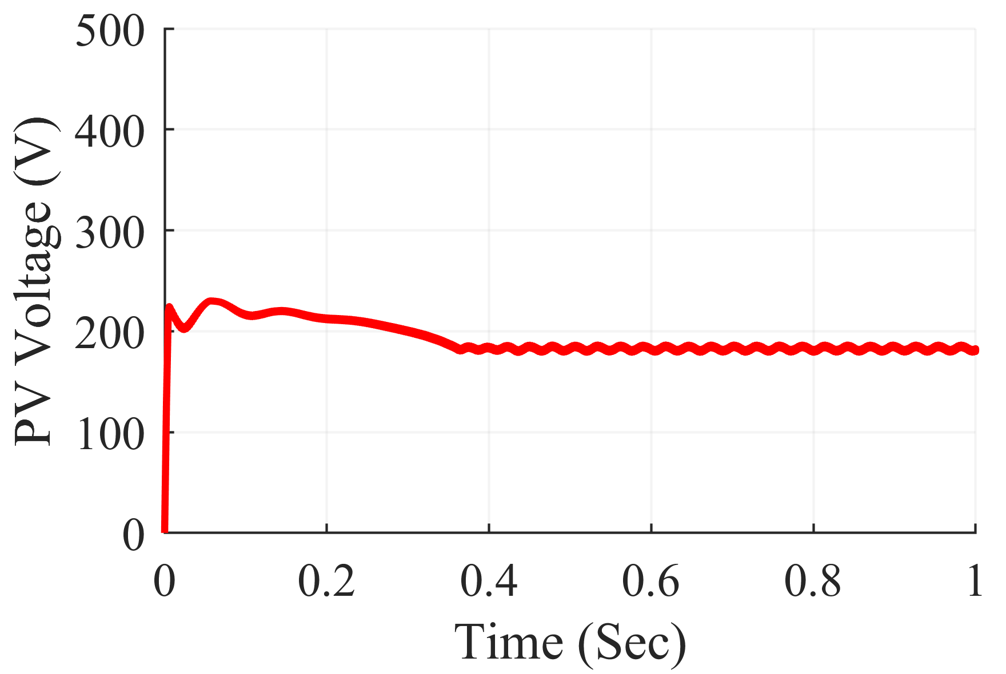
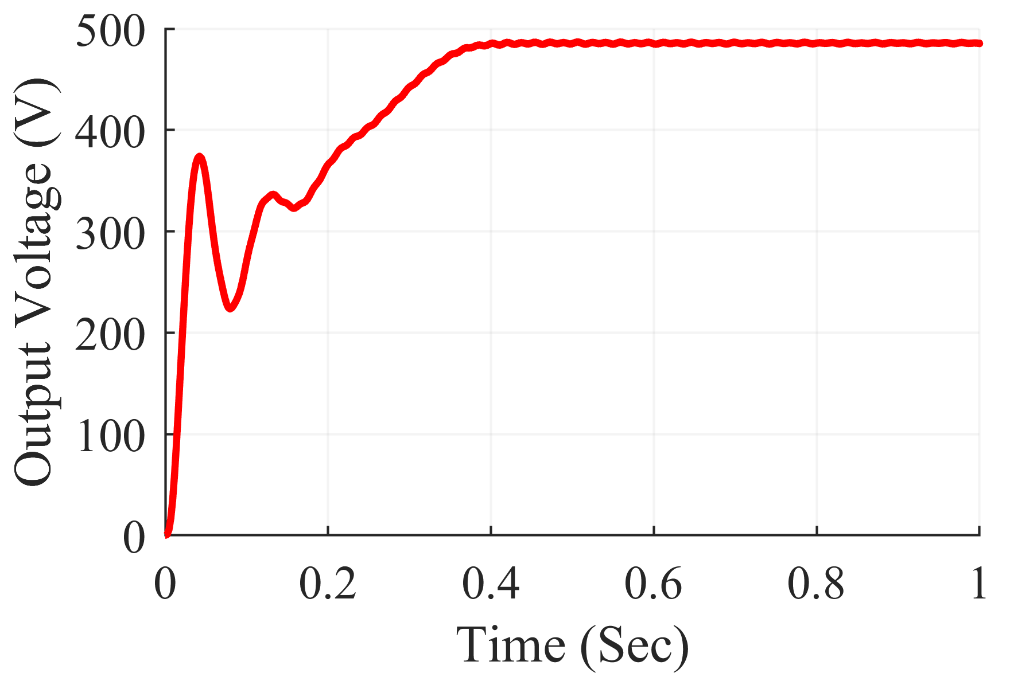
Simulation Results
Input and Output Power and Voltage Ultra-Lift Luo Converter under Uniform Shading Scenario

Slide 24
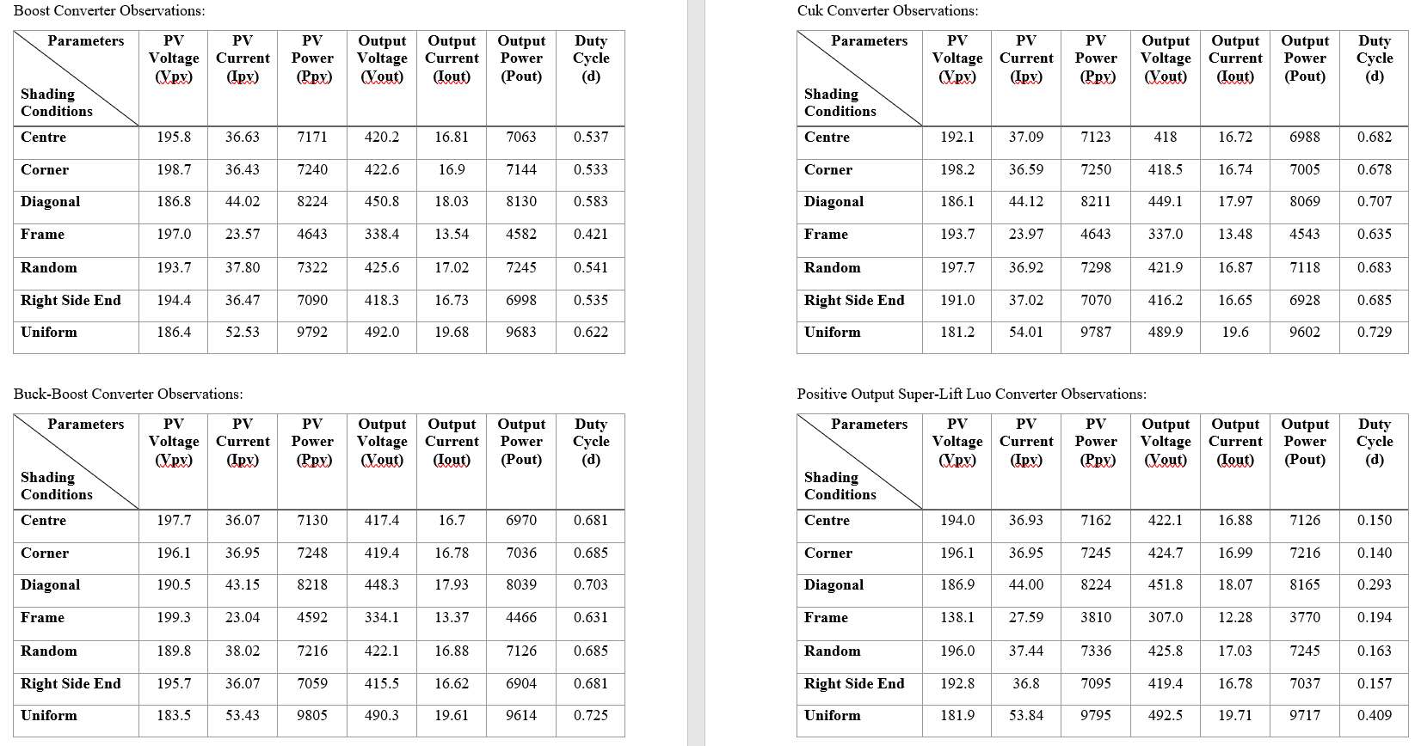

Slide 25
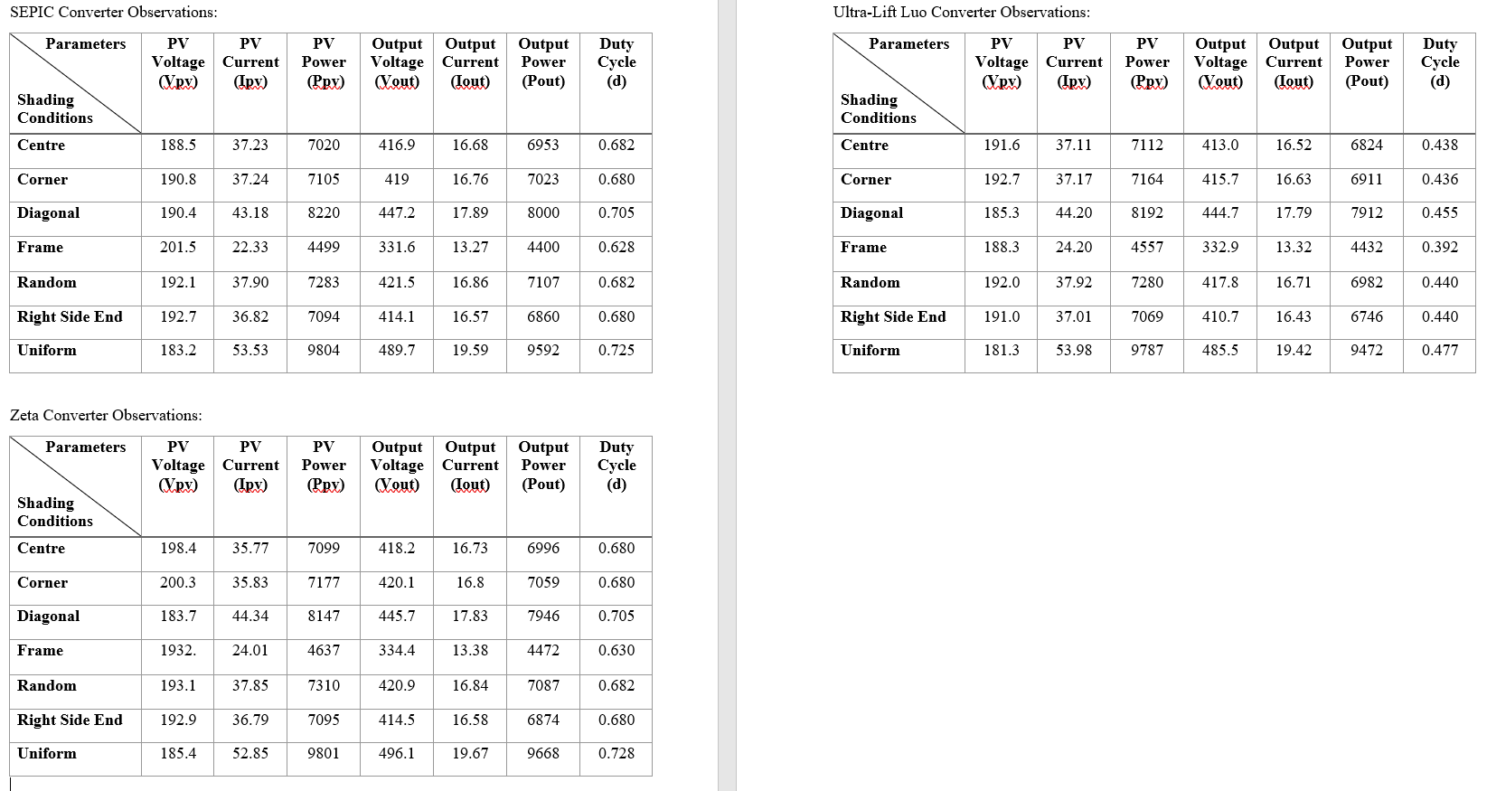

Slide 26
Conclusion
We investigated the performance of Total-Cross-Tied (TCT) PV array using Matlab/Simulimk for different partial shading scenarios.
For Stand-Alone PV system, we used the conventional non-isolated DC-DC converters such as Boost, Buck-Boost, Cuk, SEPIC and Zeta converter and High Gain non-isolated DC-DC converters such as Positive-Output Super-Lift Luo converter and Ultra-Lift Luo converter.
Under partial shading conditions, the Boost converter and Super-Lift Luo converter outperform all other converters. The output power fluctuations and ripple in the output voltage were less noticeable in these converters. These converters achieve the maximum power point faster than other converters. The Luo converter has the lowest duty ratio at the MPP, followed by the boost converter, implying that the switch in these converters will be less stressed.

Slide 27
Future Scope
More investigations on the different PV array configurations such as Bridge-Link (BL), Honey-Comb (HC), etc. needs to be analyzed.
Hybrid PV array configurations needs to be investigated such as Series-Parallel : Total-Cross-Tied (SP-TCT), Bridge-Link : Total-Cross-Tied (BL-TCT), Honey-Comb : Total-Cross-Tied (HC-TCT) and Bridge-Link : Honey-Comb (BL-HC).
The performance of the hybrid PV configurations needs to be assessed and compared with the conventional configurations under the same PSCs which are used for conventional configurations.
More number of MPPT Techniques need to be developed for fast tracking of the GMPP and fast charging of Electric Vehicle (EV) applications.
Research on Isolated DC-DC converters should be made to implement in stand-alone PV system for maximum power tracking under partial shading conditions.

Slide 28
Roadmap
01
Literature Review
of various DC-DC Converters and MPPT Techniques
Jul-Sept
02
Simulation of various MPPT DC-DC converters under different Irradiance
Oct-Dec
03
Simulation under Partial Shading conditions of various DC-DC Converters
Jan-Mar
04
Hardware Implementation for any best DC-DC Converter
Apr-Jun

Slide 29
References
Patel Mamta Z., T. B. Maniar, "Design and Simulation of Boost Converter Using P & O Technique for PV System", International Journal of Science and Research (IJSR), https://www.ijsr.net/get_abstract.php?paper_id=NOV163224, Volume 5 Issue 5, May 2016, 62 – 66
Mudhol, Altaf & Pinto, Pius. (2016). Design and Implementation of Boost Converter for Photovoltaic Systems. IJIREEICE. 4. 110-114. 10.17148/IJIREEICE/NCAEE.2016.22
Singh, Ranjit. (2019). Design & Implementation of Boost Converter for PV Cell. International Journal of Scientific Research & Growth. 6. 2321-0613.
Sholapur, Shridhar et al. “Boost Converter Topology for PV System with Perturb And Observe MPPT Algorithm.” IOSR Journal of Electrical and Electronics Engineering 9 (2014): 50-56.
Farhan Mumtaz, Nor Zaihar Yahaya, Sheikh Tanzim Meraj, Balbir Singh, Ramani Kannan, Oladimeji Ibrahim, Review on non-isolated DC-DC converters and their control techniques for renewable energy applications, Ain Shams Engineering Journal 2021, 2090-4479.
L. Jotham Jeremy, Chia Ai Ooi, and Jiashen Teh , "Non-isolated conventional DC-DC converter comparison for a photovoltaic system: A review", Journal of Renewable and Sustainable Energy 12, 013502 (2020)
Sajad Ahmad Tali, Faroze Ahmad (2020) INVESTIGATION OF NON ISOLATED DC-DC CONVERTERS USED IN PHOTOVOLTAIC SYSTEMS USING MATLAB SIMULATION. JCR, 7 (18), 1390-1396.
M. A. Chewale, R. A.Wanjari, V. B.Savakhande and P. R.Sonawane, "A Review on Isolated and Non-isolated DC-DC Converter for PV Application," 2018 International Conference on Control, Power, Communication and Computing Technologies (ICCPCCT), 2018, pp. 399-404.
R. Reshma Gopi, S. Sreejith, Converter topologies in photovoltaic applications – A review, Renewable and Sustainable Energy Reviews, Volume 94, 2018, Pages 1-14, ISSN 1364-0321.

Slide 30
Thank You

